Slide 1
The Guide
Understanding Mental Health and Mental Illness

Slide 2
Table of Contents
Topic A: What is mental health?
Topic B: How is the brain involved in mental health?
Topic C: What is stigma?
Topic D: How can a person find support?
Topic E: How can positive mental health be maintained?
Notes:
Say:
Welcome back to The Guide! As mentioned, before I will be here for about 5 classes. Last week we worked “Topic A- What is Mental Health” and today we are onto “Topic B- How is the brain involved in mental health?”
Do:
Review class rules or other important items as needed.
Ask:
Can someone remind us of a few things we learned last time we met?
Take 2-3 examples and move on to the next slide

Slide 3
Topic B:
How is the Brain Involved in Mental Health?
[Insert teacher / facilitator name]

Slide 4
Topic B: How is the brain involved in mental health?
Activity 1: The Brain is in Control
Understanding Mental Health and Mental Illness
Activity 2: Can you guess the mental state?
Notes:
Say:
Today we will be discussing lots of things!
We will be discussing how the brain works
We will be talking about the difference between mental health and mental illness and other feelings, and
We will be talking more about the functions of the brain/how the brain works
Do:
Provide agenda of what Topic B will cover (this slide)
Ask:
“Any questions before we get started?

Slide 5
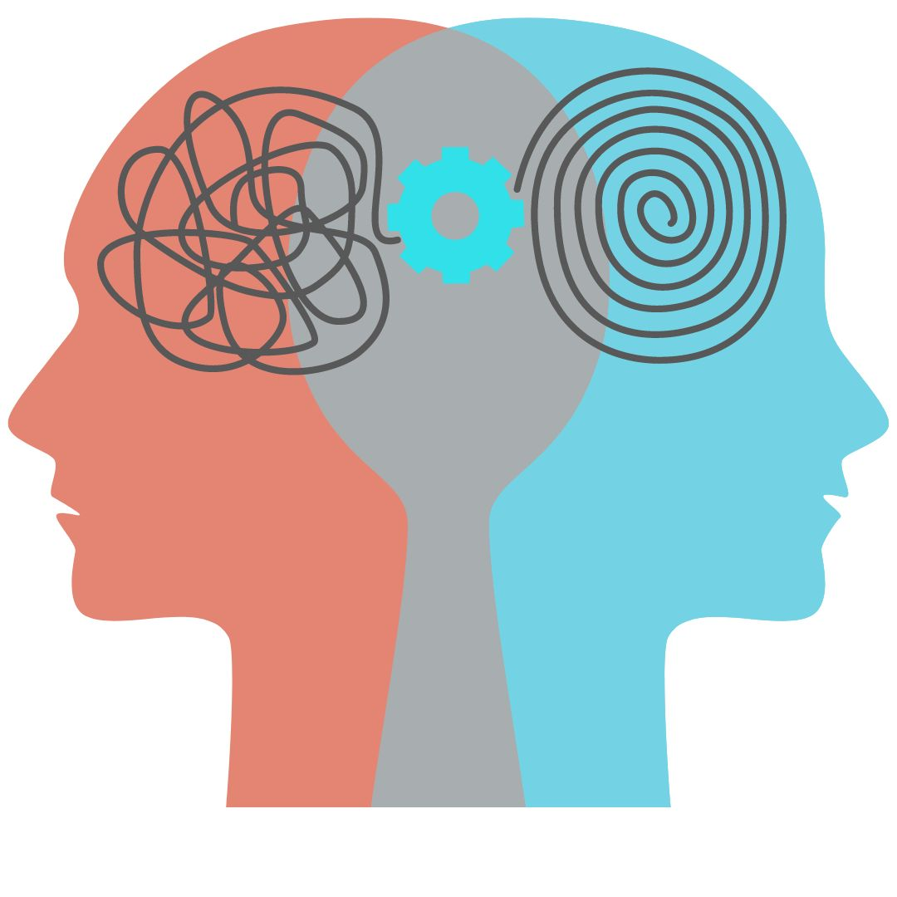
Activity 1: The Brain is in Control
The Brain is in Control Activity/Video: Teen Brain HD
Notes:
Say:
Today we are going to be learning about how the Brain controls everything in your body. The brain controls cognitions (what we think), perception (how we interpret things), emotions (our feelings), physical functions (breathing, using the bathroom, our heart breathing), signaling (takes information from the outside worlds and sends it to our brain- sends signals from our hands to our brain to say we picked up something hot), and behaviors (how we act).
To start us off we are going to watch a short video. The video goes fast so make sure to pay attention. It’s a lot of information in a quick 3.5 minutes.
Do:
Watch movie
Ask:
SEE question on the next slide

Slide 6
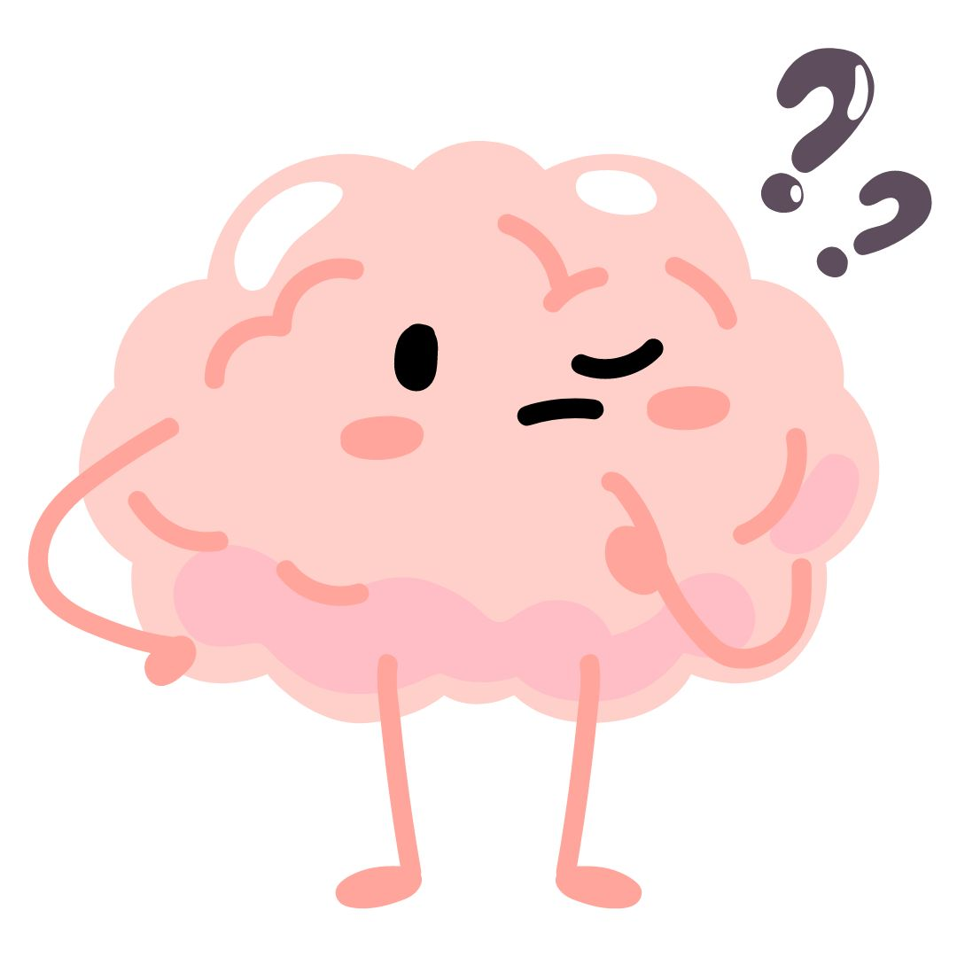
Activity I: The Brain is in Control
What information stood out to you?
Was any of the information surprising?
Did any of the information make you want to pause for consideration?
Why do you think the video was created in this style?
What message is intended to be communicated by the video?
Notes:
Optional:
Replay video to give students another opportunity to further absorb content. “Do you want to see it again?”
Say:
That was a lot of information! Let’s discuss…what did you think about what you just watched?
Do:
Give students the opportunity to reflect and ask questions below/on the slide. There are a few follow up questions to assist if needed.
Ask:
What information stood out to you?
Did you know the brain did so much?
Was any of the information surprising?
What surprised you the most
Did any of the information make you want to pause for consideration?
Did you think about how your treat your brain
Why do you suppose the video was created in this style?
Did it keep your attention?
What message is intended to be communicated by the video?
Say/Summarize:
Use some of the words students used to answer the questions above and summarize the purpose,
“To summarize…The brain controls cognitions (what we think), perception (how we interpret things), emotions (our feelings), physical functions (breathing, using the bathroom), signaling (takes information from the outside worlds and sends it to our brain- sends signals from our hands to our brain to say we picked up something hot), and behaviors (how we act). We are going to take a deeper look at the brain functions a little later.”
Say:
“Now that we understand a little more about all that our brain controls and all that it does, we are going to move discuss mental health and mental illness”.

Slide 7
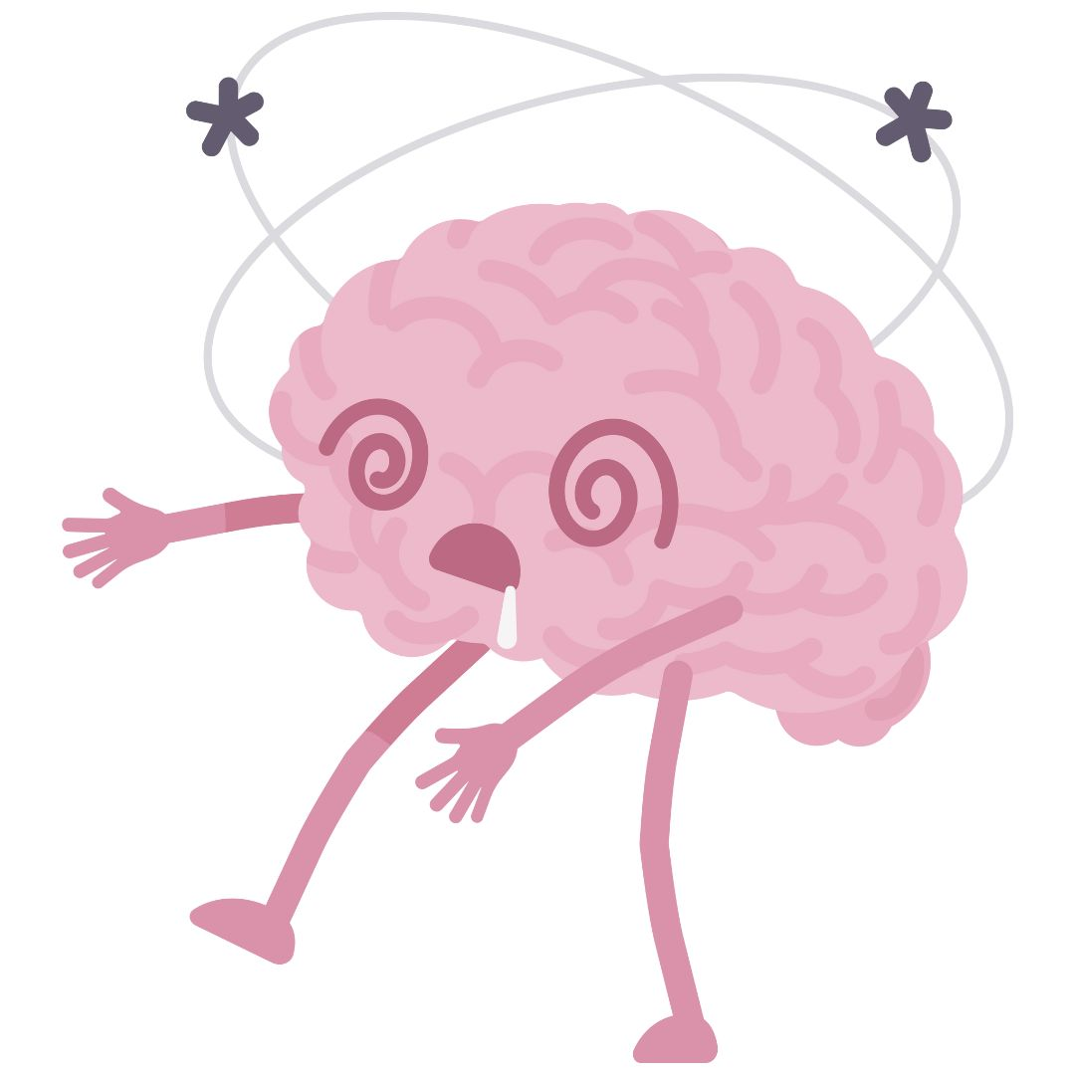
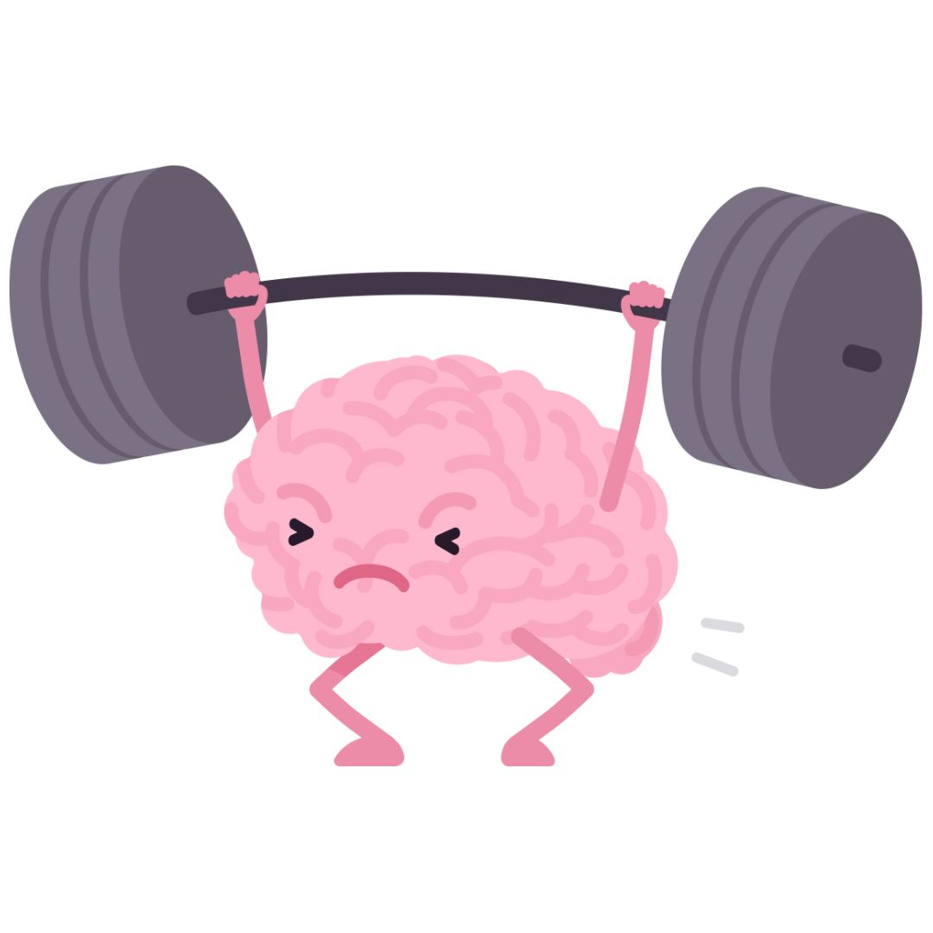
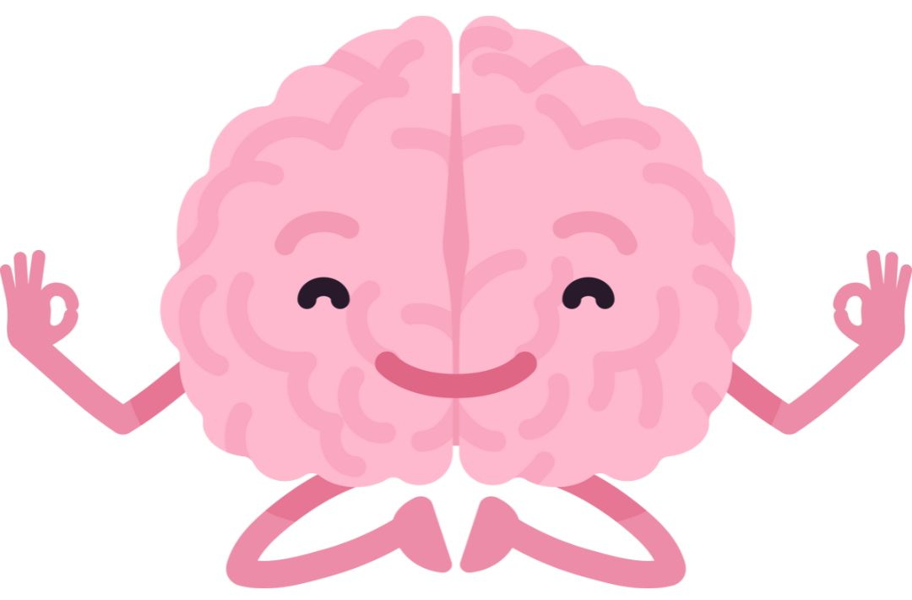
Understanding Mental Health and Mental Illness
How would you define mental health?
How would you define mental illness?
Notes:
Say:
Let’s talk about Mental Health and Mental Illness…I’m curious what you know about these words?
Do:
You can do this in small groups and have a reporter or as a whole class discussion* Write on the board or large piece of paper answers provided by students. You will be going into this in depth in a few. You want to get a few of their ideas here but for time, don’t spend too much time here.
Ask:
Let’s start with mental health. When you think of mental health what do you think of? What does it mean?
Now let’s talk about mental illness. When you think of mental illness what do you think of? What does it mean?

Slide 8
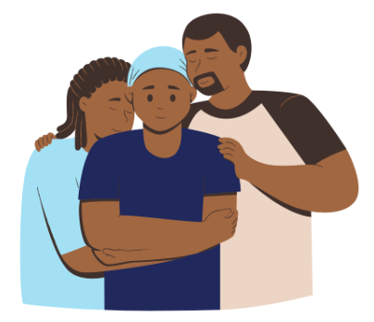
Understanding Mental Health and Mental Illness
Mental Health: is experienced through emotional, behavioral, physical, cognitive and social functions that enable us to feel, think and act in ways that enhance our ability to enjoy life and deal with challenges. It does not mean a lack of distress, emotions or bad moods, or a lack of a behavioral disorder.
Notes:
Say:
We are going to talk more about this in a little but I’m curious, what do you think…
Do:
Read the definitions provided on the slide
Ask:
How might it be possible to have mental health and mental illness at the same time?
Are all problems with mental health considered to be mental illness?
Is there a difference?
Facilitator note:
As the presenter, you don’t need to answer these questions, they are for students to ponder. These will be addressed later in the session.
Say:
These are big questions, let’s talk more about the differences!

Slide 9
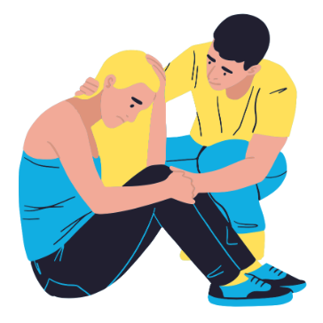
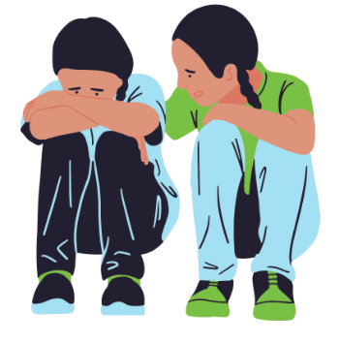
Understanding Mental Health and Mental Illness
Mental Illness: is a medical condition diagnosed by trained health professional using internationally established diagnostic criteria. Mental illness is when a person experiences significant, substantial and persistent problems with thoughts, feelings, and behaviors. It is important to remember that when a person is diagnosed with a mental illness they do not lose their mental health.
Notes:
Say:
We are going to talk more about this in a little but I’m curious, what do you think…
Do:
Read the definitions provided on the slide
Ask:
How might it be possible to have mental health and mental illness at the same time?
Are all problems with mental health considered to be mental illness?
Is there a difference?
Facilitator note:
As the presenter, you don’t need to answer these questions, they are for students to ponder. These will be addressed later in the session.
Say:
These are big questions, let’s talk more about the differences!

Slide 10
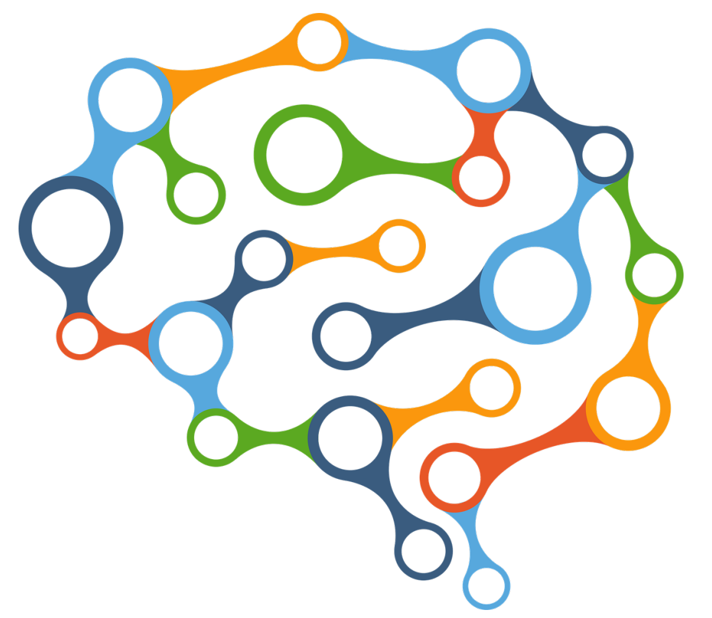
Understanding the Relationship Between Mental Health and Mental Illness
Notes:
Say:
Let’s take a deeper look

Slide 11
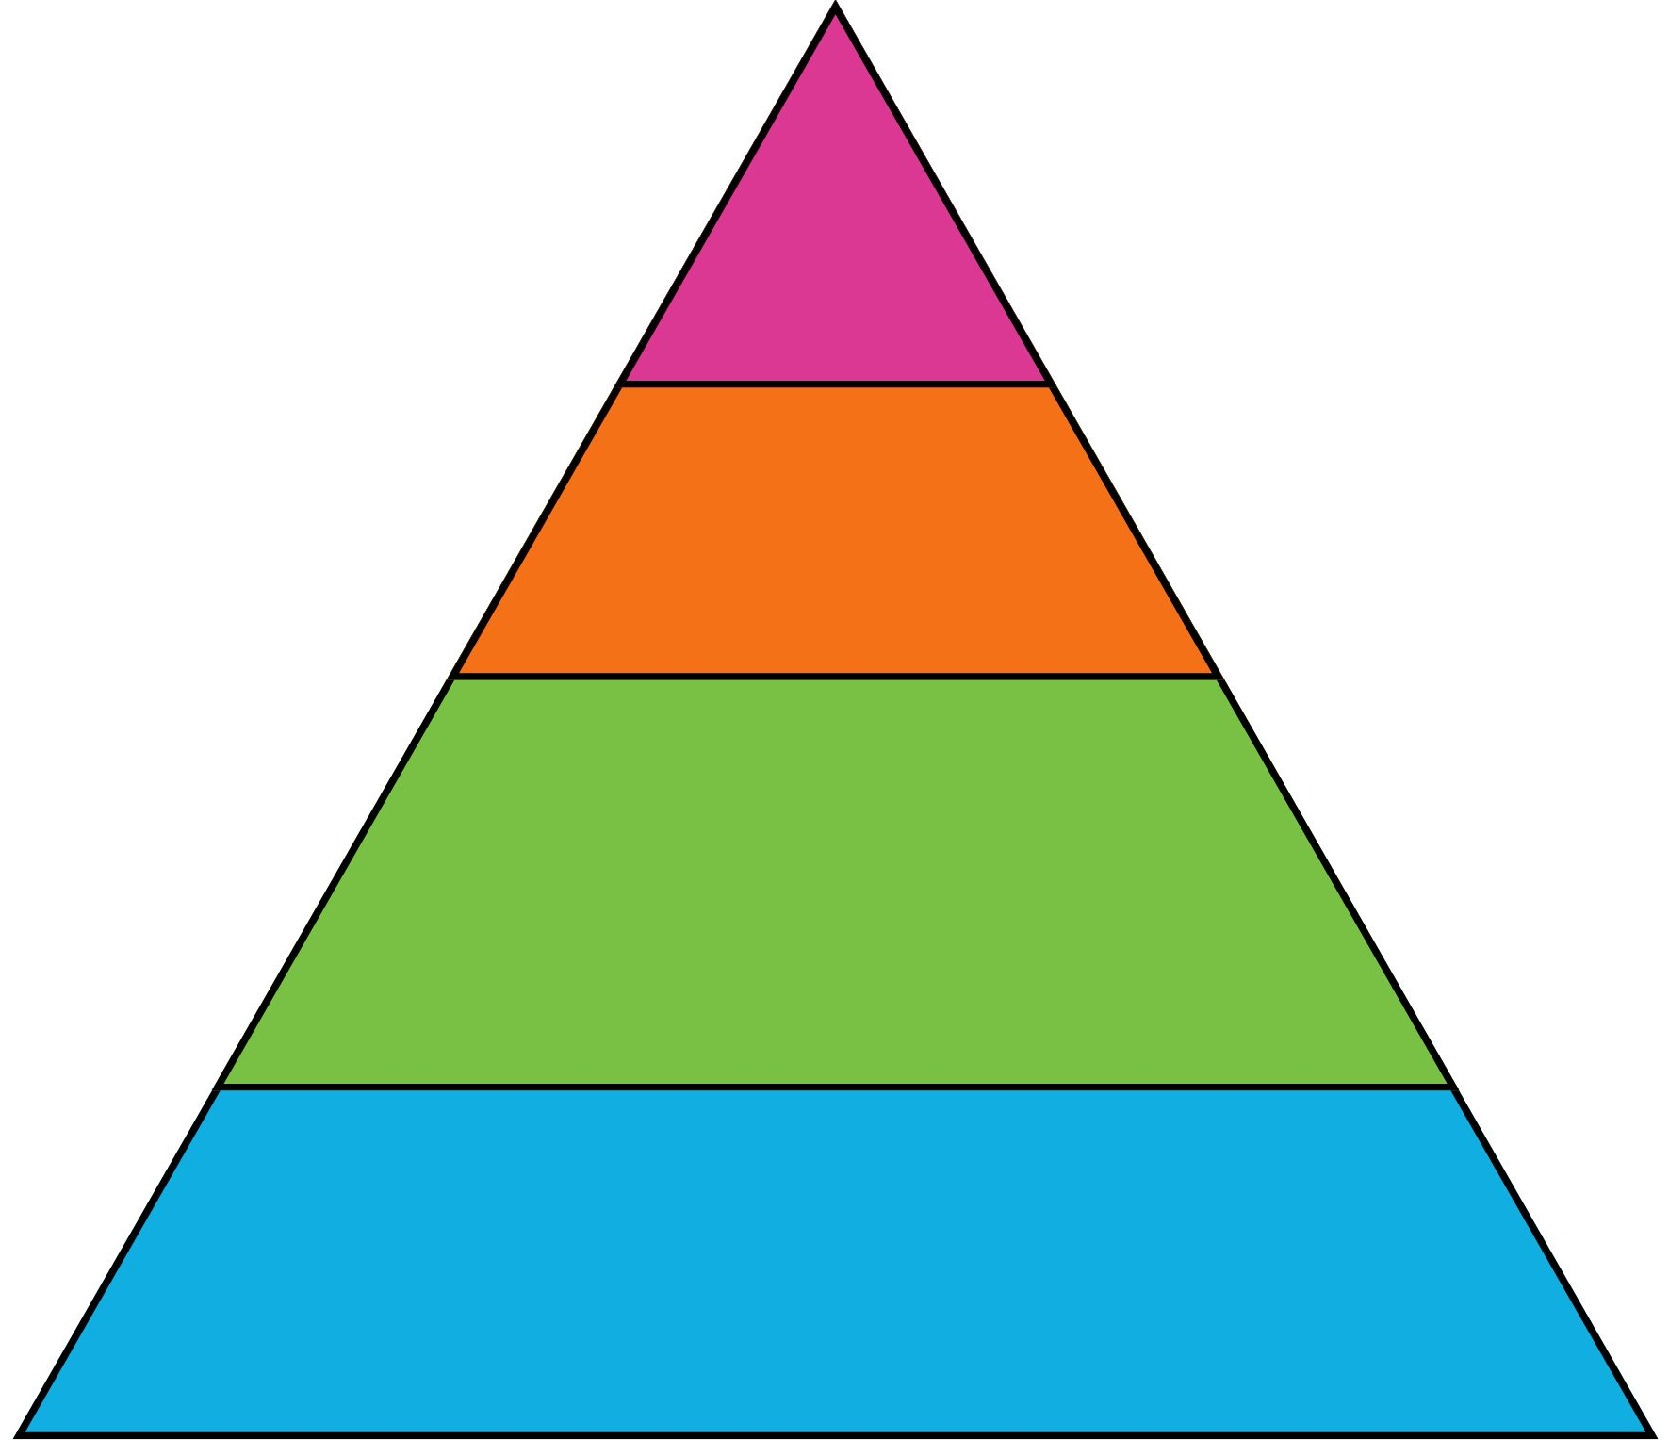
Understanding Mental Health States: What the Words Mean
Mental Disorder or Illness
Mental Health Problem
Mental Distress
No Distress, Problem or Disorder
Stress can be helpful
Notes:
Review the slide and discuss their understanding of the terms presented.
**Re: Stress can be helpful; ask students to think of ways that stress can be helpful or productive (ex: feeling stress about a test can encourage you to prepare better for it)
Say:
There’s a little more than just Mental Illness and Mental Health. There are a few levels to consider as we see in this slide.
A person can be in one or more of these states at the same time. For example, a person can have Schizophrenia (a mental illness), their pet dog has died (a mental health problem), and they lost their homework on the way to school (mental distress), yet they are walking to school with their friends and enjoying themselves.
It may be easiest to think about mental health states in a triangle
On the right side you see that there are 4 different Mental Health States- read the states
On the left side you can see a description of what each state may experience
You can think of the amount of people who experience each level has how big of an area in the triangle the level take up. For example, the Mental Illness area is only a small area, meaning most people do not experience a true mental health disorder.
Do:
Read each level and the description
Ask:
Who can provide an example of one of the mental health states? Try to get and example for each mental health state?
How many of you have experienced one or more of these states (NORMALIZE this experience)
Say:
Let’s talk about each level a little more…..(next slides will provide more details on each level)

Slide 12
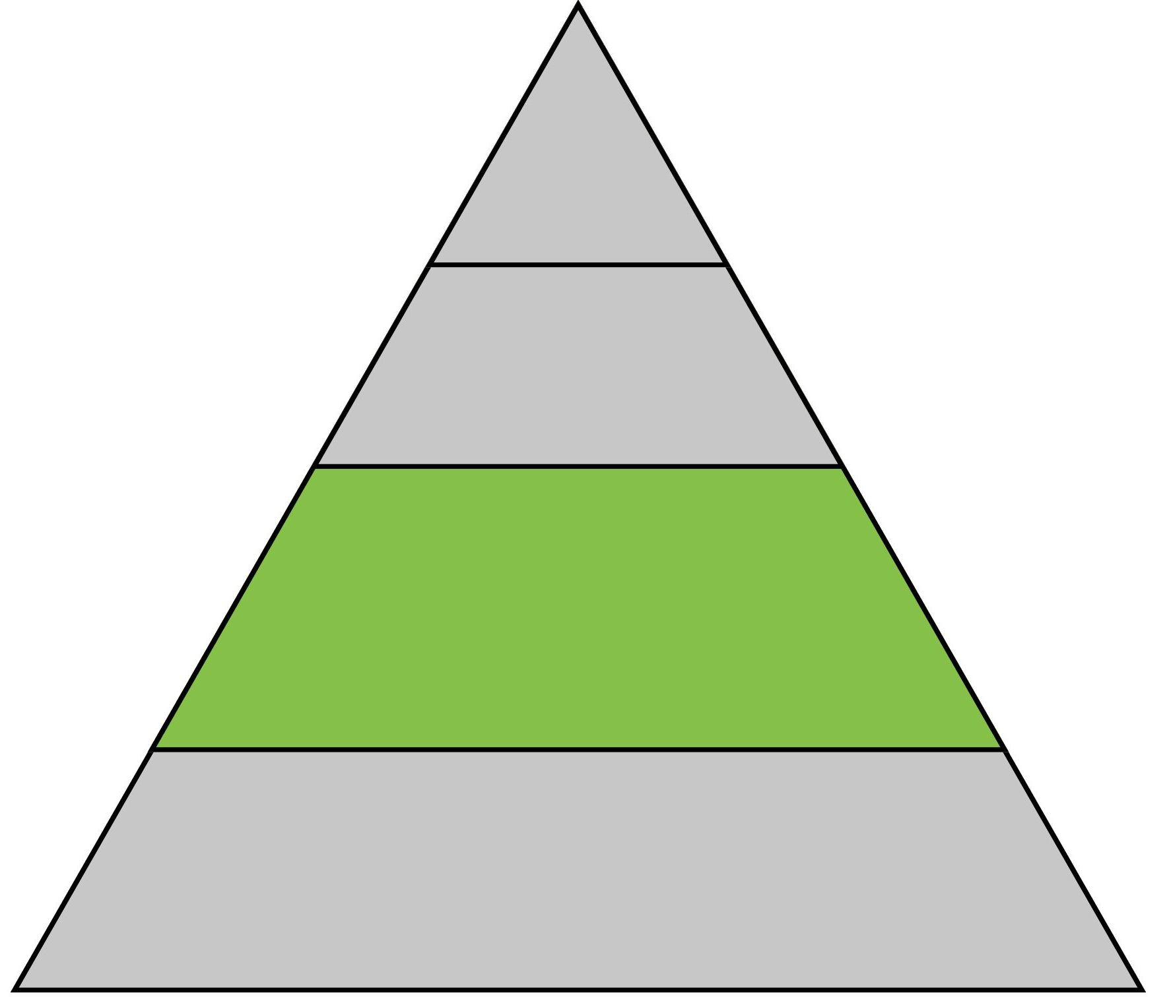
Mental Distress
The brain’s expected and usual response to the stresses of everyday life (e.g., exams, relationships, disappointments)
Happens to everyone every day
Leads to adaptation, learning and coping
Mental Distress
Often seen as negative instead of as helpful
Must reframe as positive, excitement not stress, called “Eustress” or “Good Stress”
Notes:
Do:
Review the slide and discuss their understanding of the terms presented.
Say:
There’s a little more than just Mental Illness and Mental Health. There are a few levels to consider as we see in this slide.
A person can be in one or more of these states at the same time. For example, a person can have Schizophrenia (a mental illness), their pet dog has died (a mental health problem), and they lost their homework on the way to school (mental distress), yet they are walking to school with their friends and enjoying themselves.
It may be easiest to think about mental health states in a triangle
On the right side you see that there are 4 different Mental Health States- read the states
On the left side you can see a description of what each state may experience
You can think of the amount of people who experience each level has how big of an area in the triangle the level take up. For example, the Mental Illness area is only a small area, meaning most people do not experience a true mental health disorder.
Do:
Read each level and the description
Ask:
Who can provide an example of one of the mental health states? Try to get and example for each mental health state?
How many of you have experienced one or more of these states (NORMALIZE this experience)
Say:
Let’s talk about each level a little more…..(next slides will provide more details on each level)

Slide 13
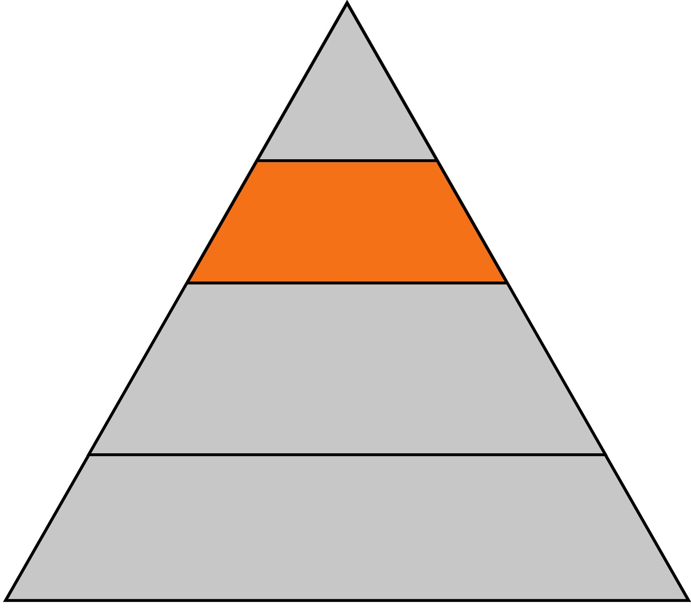
Mental Health Problem
The brain’s response to a severe or persistent life problem (e.g., death of a family member, severe bullying, parents’ divorce)
Mental Health Problem
Happens to everyone many times in their life
Shows that adaptation is difficult
May require additional help (such as a counselor or therapist)
Notes:
Do:
Review the slide and discuss their understanding of the terms presented.
Say:
There’s a little more than just Mental Illness and Mental Health. There are a few levels to consider as we see in this slide.
A person can be in one or more of these states at the same time. For example, a person can have Schizophrenia (a mental illness), their pet dog has died (a mental health problem), and they lost their homework on the way to school (mental distress), yet they are walking to school with their friends and enjoying themselves.
It may be easiest to think about mental health states in a triangle
On the right side you see that there are 4 different Mental Health States- read the states
On the left side you can see a description of what each state may experience
You can think of the amount of people who experience each level has how big of an area in the triangle the level take up. For example, the Mental Illness area is only a small area, meaning most people do not experience a true mental health disorder.
Do:
Read each level and the description
Ask:
Who can provide an example of one of the mental health states? Try to get and example for each mental health state?
How many of you have experienced one or more of these states (NORMALIZE this experience)
Say:
Let’s talk about each level a little more…..(next slides will provide more details on each level)

Slide 14
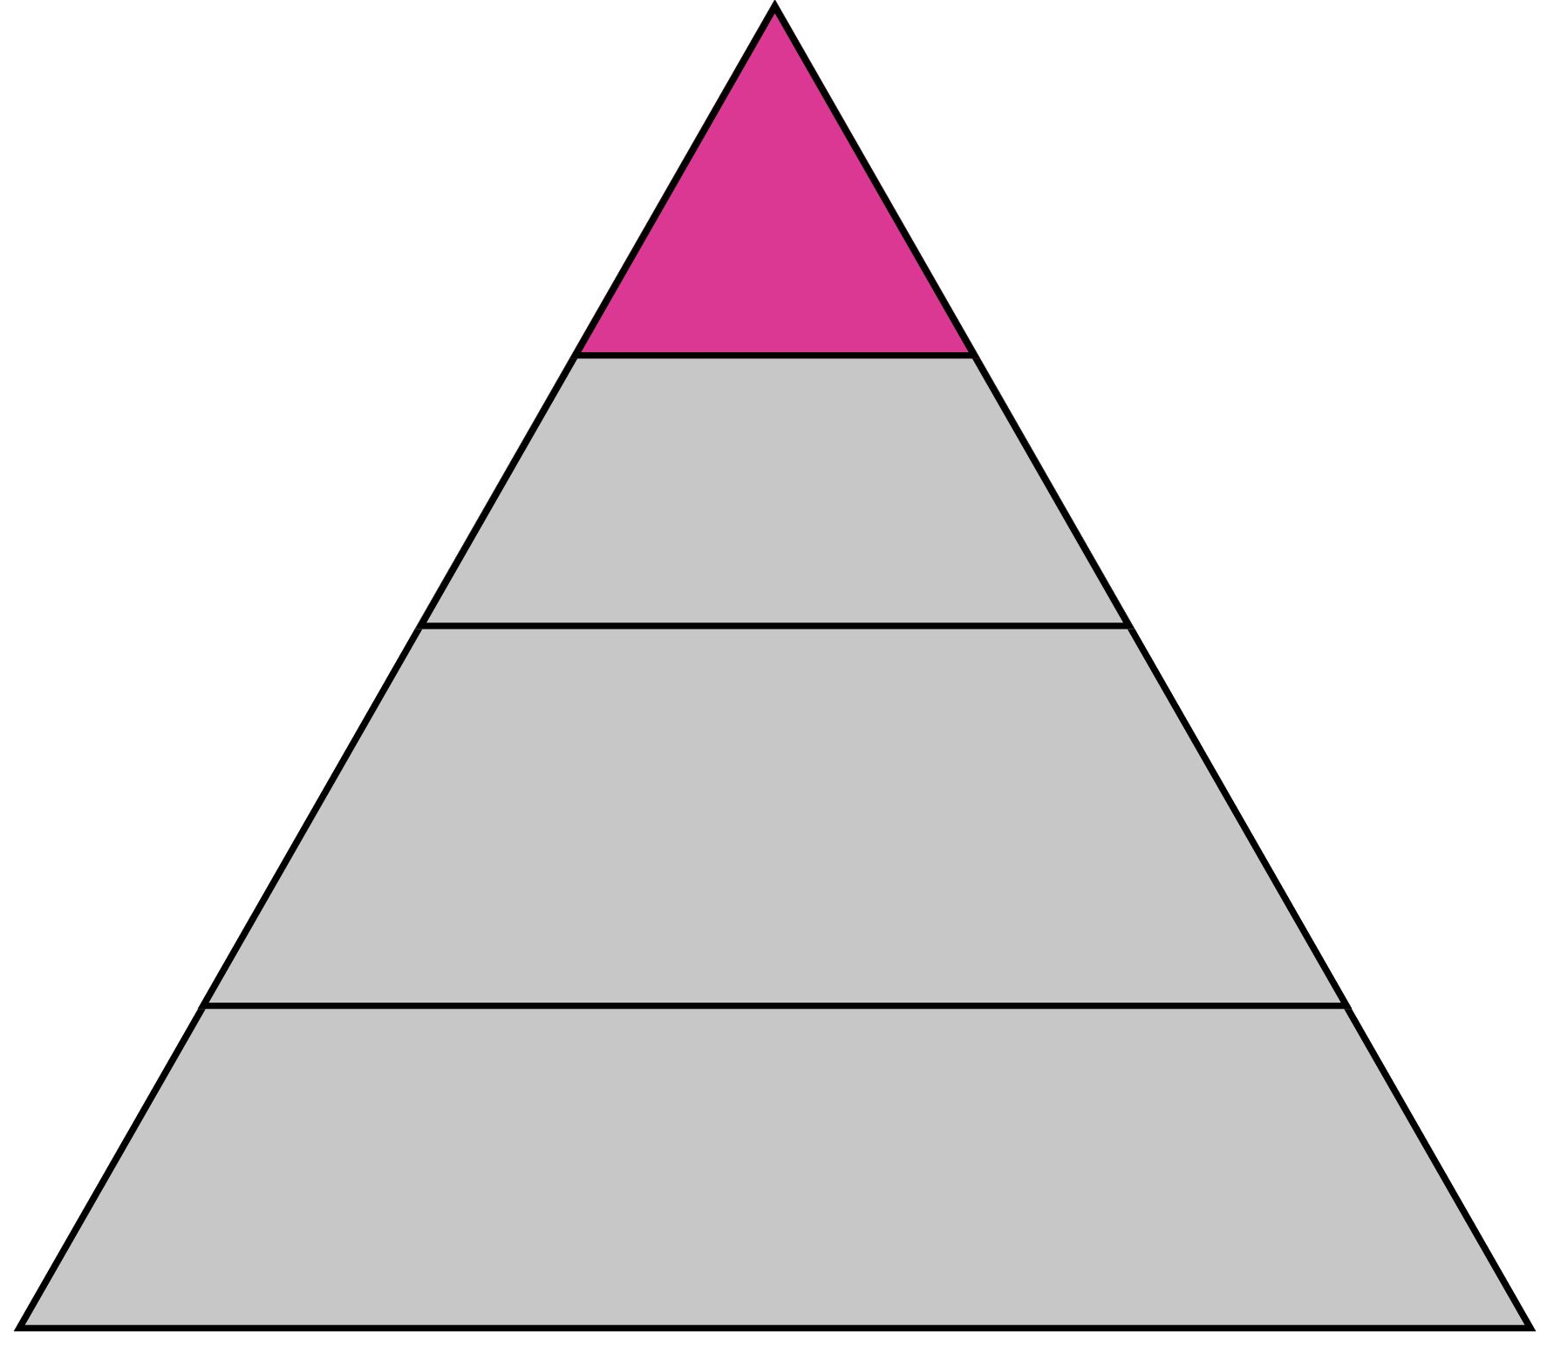
Mental Disorder or Illness
Mental Disorder or Illness
Can impact how the brain is functioning leading to problems in a person’s everyday life. It can be caused a combination of genetic and environmental factors.
Happens to at least 1/5 people in their lifetime.
Must be diagnosed by a health professional.
Requires treatments provided by a trained health professional
Notes:
Do:
Review the slide and discuss their understanding of the terms presented.
Say:
There’s a little more than just Mental Illness and Mental Health. There are a few levels to consider as we see in this slide.
A person can be in one or more of these states at the same time. For example, a person can have Schizophrenia (a mental illness), their pet dog has died (a mental health problem), and they lost their homework on the way to school (mental distress), yet they are walking to school with their friends and enjoying themselves.
It may be easiest to think about mental health states in a triangle
On the right side you see that there are 4 different Mental Health States- read the states
On the left side you can see a description of what each state may experience
You can think of the amount of people who experience each level has how big of an area in the triangle the level take up. For example, the Mental Illness area is only a small area, meaning most people do not experience a true mental health disorder.
Do:
Read each level and the description
Ask:
Who can provide an example of one of the mental health states? Try to get and example for each mental health state?
How many of you have experienced one or more of these states (NORMALIZE this experience)
Say:
Let’s talk about each level a little more…..(next slides will provide more details on each level)

Slide 15
Understanding Mental Health States: What the Words Mean
Mental Disorder or Illness
Depression
Sorrowful, grieving, mournful, feeling temporary despair
Mental Health Problem
Upset, angry, disappointed, annoyed, sad, pessimistic
Mental Distress
No Distress, Problem or Disorder
No concerns
Notes:
Do:
Review the slide and discuss their understanding of the terms presented.
Say:
There’s a little more than just Mental Illness and Mental Health. There are a few levels to consider as we see in this slide.
A person can be in one or more of these states at the same time. For example, a person can have Schizophrenia (a mental illness), their pet dog has died (a mental health problem), and they lost their homework on the way to school (mental distress), yet they are walking to school with their friends and enjoying themselves.
It may be easiest to think about mental health states in a triangle
On the right side you see that there are 4 different Mental Health States- read the states
On the left side you can see a description of what each state may experience
You can think of the amount of people who experience each level has how big of an area in the triangle the level take up. For example, the Mental Illness area is only a small area, meaning most people do not experience a true mental health disorder.
Do:
Read each level and the description
Ask:
Who can provide an example of one of the mental health states? Try to get and example for each mental health state?
How many of you have experienced one or more of these states (NORMALIZE this experience)
Say:
Let’s talk about each level a little more…..(next slides will provide more details on each level)

Slide 16
Understanding Mental Health States: What the Words Mean
Mental Disorder or Illness
Anxiety
Overwhelmed, fixated, “triggered”
Mental Health Problem
Stressed, worried, overthinking a problem
Mental Distress
No Distress, Problem or Disorder
At ease, no worries
Notes:
Do:
Review the slide and discuss their understanding of the terms presented.
Re: ‘triggered’
Cambridge dictionary defines triggered as “experiencing a strong emotional reaction of fear, shock, anger, or worry, especially because you are made to remember something bad that has happened in the past”
This word is used often when talking about something that might be generally upsetting to someone, but is also used by individuals who are diagnosed with PTSD (Post Traumatic Stress Disorder)
Say:
There’s a little more than just Mental Illness and Mental Health. There are a few levels to consider as we see in this slide.
A person can be in one or more of these states at the same time. For example, a person can have Schizophrenia (a mental illness), their pet dog has died (a mental health problem), and they lost their homework on the way to school (mental distress), yet they are walking to school with their friends and enjoying themselves.
It may be easiest to think about mental health states in a triangle
On the right side you see that there are 4 different Mental Health States- read the states
On the left side you can see a description of what each state may experience
You can think of the amount of people who experience each level has how big of an area in the triangle the level take up. For example, the Mental Illness area is only a small area, meaning most people do not experience a true mental health disorder.
Do:
Read each level and the description
Ask:
Who can provide an example of one of the mental health states? Try to get and example for each mental health state?
How many of you have experienced one or more of these states (NORMALIZE this experience)
Say:
Let’s talk about each level a little more…..(next slides will provide more details on each level)

Slide 17
Understanding Mental Health States
A person can be in one or more of these mental health states at the same time!
A person can have depression (a mental disorder), or their family member has recently died (a mental health problem), or they lost their house keys earlier today (mental distress) or be hanging out with a friend and enjoying themselves.
Notes:
Do:
Review the slide and discuss their understanding of the terms presented.
Say:
There’s a little more than just Mental Illness and Mental Health. There are a few levels to consider as we see in this slide.
A person can be in one or more of these states at the same time. For example, a person can have Schizophrenia (a mental illness), their pet dog has died (a mental health problem), and they lost their homework on the way to school (mental distress), yet they are walking to school with their friends and enjoying themselves.
It may be easiest to think about mental health states in a triangle
On the right side you see that there are 4 different Mental Health States- read the states
On the left side you can see a description of what each state may experience
You can think of the amount of people who experience each level has how big of an area in the triangle the level take up. For example, the Mental Illness area is only a small area, meaning most people do not experience a true mental health disorder.
Do:
Read each level and the description
Ask:
Who can provide an example of one of the mental health states? Try to get and example for each mental health state?
How many of you have experienced one or more of these states (NORMALIZE this experience)
Say:
Let’s talk about each level a little more…..(next slides will provide more details on each level)

Slide 18
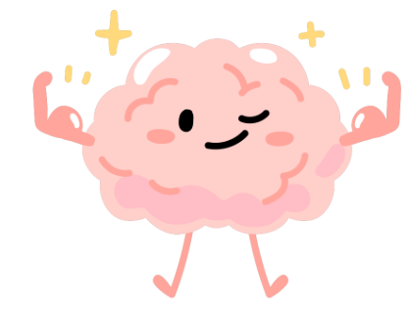
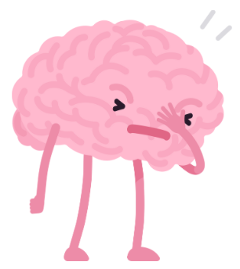
The Brain
Mental health is brain health
The presence of mental distress or a mental health problem is an example of your brain working to help you adapt to life’s challenges and develop skills for future challenges.
The same way that your body has an immune system to help you adapt to infections and develop better immunity for future infections
Notes:
Do:
Review the slide and discuss their understanding of the terms presented.
Say:
There’s a little more than just Mental Illness and Mental Health. There are a few levels to consider as we see in this slide.
A person can be in one or more of these states at the same time. For example, a person can have Schizophrenia (a mental illness), their pet dog has died (a mental health problem), and they lost their homework on the way to school (mental distress), yet they are walking to school with their friends and enjoying themselves.
It may be easiest to think about mental health states in a triangle
On the right side you see that there are 4 different Mental Health States- read the states
On the left side you can see a description of what each state may experience
You can think of the amount of people who experience each level has how big of an area in the triangle the level take up. For example, the Mental Illness area is only a small area, meaning most people do not experience a true mental health disorder.
Do:
Read each level and the description
Ask:
Who can provide an example of one of the mental health states? Try to get and example for each mental health state?
How many of you have experienced one or more of these states (NORMALIZE this experience)
Say:
Let’s talk about each level a little more…..(next slides will provide more details on each level)

Slide 19
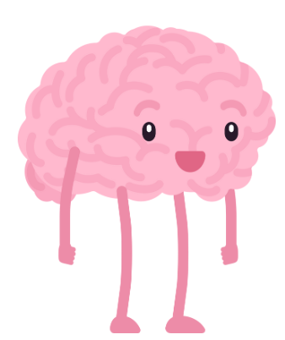
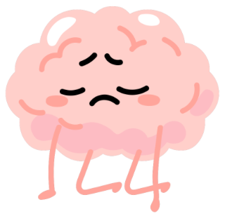
Being Healthy Does Not Mean Never Experiencing Problems
Negative emotions (e.g., worry, fear, sadness) are not necessarily a sign of mental illness – they are usually part of a mental healthy response to a mental stressor (such as a romantic disappointment)
Just like negative physical symptoms (e.g., fever, fatigue, cough) are not necessarily a sign of physical illness – they are usually part of a healthy response to a physical stressor (such as a virus/illness)
Notes:
Say:
Dealing with stress/mental distress and mental health problems is a way of taking care of our health. If we ignore it, we will likely get worse.
Do:
Check for understanding
Ask:
Anyone ever try to ignore an issue and it didn’t go away?

Slide 20
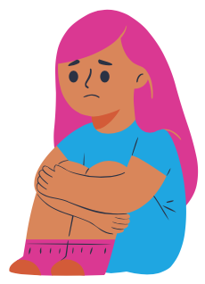
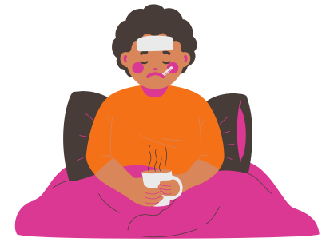
The Brain and the Body
Life Stress: Romantic breakup
Life Stress: Infection or Illness
Brain responds with negative feelings (e.g., sad, worried) and behaviors (e.g., crying, loss of appetite)
Your brain adapts and you learn how to cope and now you are stronger in case it happens again
Body responds with increasing temperature (e.g., fever) and negative physical sensations (e.g., aching muscles, fatigue)
Your immune system fights off the virus/illness and now you are stronger in case it comes back
Notes:
Say:
Just like physical health, we all have mental health and here are a few examples.
Do:
Check for understanding
Ask:
Does this make sense? Any questions or comments?

Slide 21
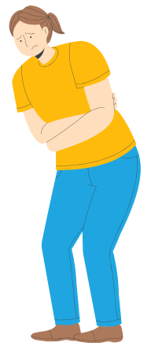
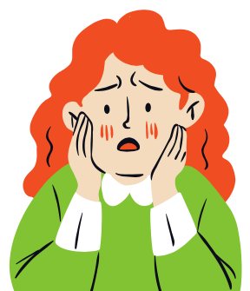
The Brain and the Body are Connected
Feelings
Physical Symptoms
Sadness
Worry
Anxiety
Unhappiness
Disappointment
Embarrassment
Anger
Grief
Fear
Muscle tension
Headaches
Stomach aches
Intestinal (bathroom) issues
Flushing/red face
Tingling
Difficulty breathing
Heart pounding
Sweating
Notes:
Say:
As we’ve been discussing, the brain and body are very much connected.
Sometimes, we have physical symptoms that are caused by our emotions, not an illness. Feelings can make our body feel sore, give us headaches, make us feel like we are having a heart attack- some of you may be familiar with panic attacks. This does not mean we are dying of a heart attack, it means our emotions/feelings are so strong that they are giving us physical symptoms, and this is our clue that it is time to ask for help.
Do:
Ensure students understand that feelings can cause physical symptoms.
Discuss other possible links for brain and body
Ask:
Has anyone ever had a headache or stomach ache before a big test, big performance or other event you were worried about? That’s your brain telling you to take a minute and address your mental health.

Slide 22
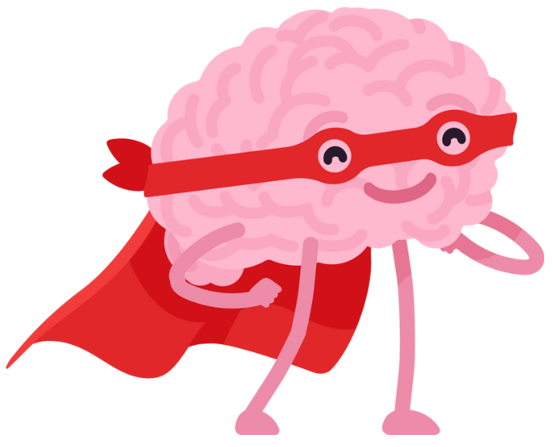
What is the Brain?
The brain is the most complex organ in the body – the “master control center”
Considered to be the most complex thing known in medicine
Made up of many different cells called neurons as well as other cells that support these neurons
Neurons are arranged in very complex networks also called circuits. They control things like movement, thinking, etc. Neurons communicate using chemical messengers.
Notes:
Say:
Let’s learn a little more about the brain.
Do:
Read the slide
Ask:
What else do you know about the brain? What did we learn from the video?

Slide 23
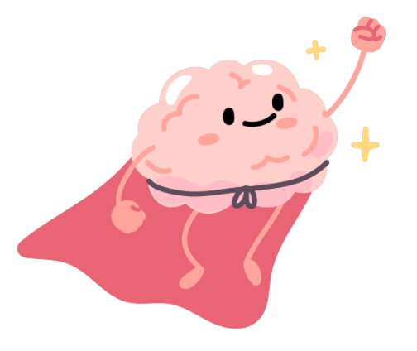
What does the Brain Do?
Almost everything!
Notes:
Say:
So what does the brain do? Almost everything! Let’s keep looking at it.

Slide 24
Your brain develops and changes over your entire life!
Notes:
Say:
In the next slides we will review the different domains or parts of the brain and their functions that develop or change over time.

Slide 25
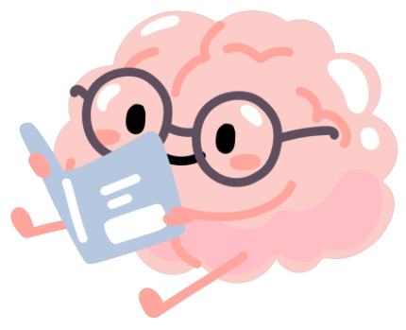
Functions of the Brain
1) Thinking or Cognition
Notes:
Say:
The brain is in charge of our cognitions or in other words, our thoughts and thinking.
Ask:
Tell me some ways thinking helps you to learn new things.
Examples:
Being curious
Wondering how things work
Thinking and analyzing how things happened.
Do:
You could list the answers on the board

Slide 26
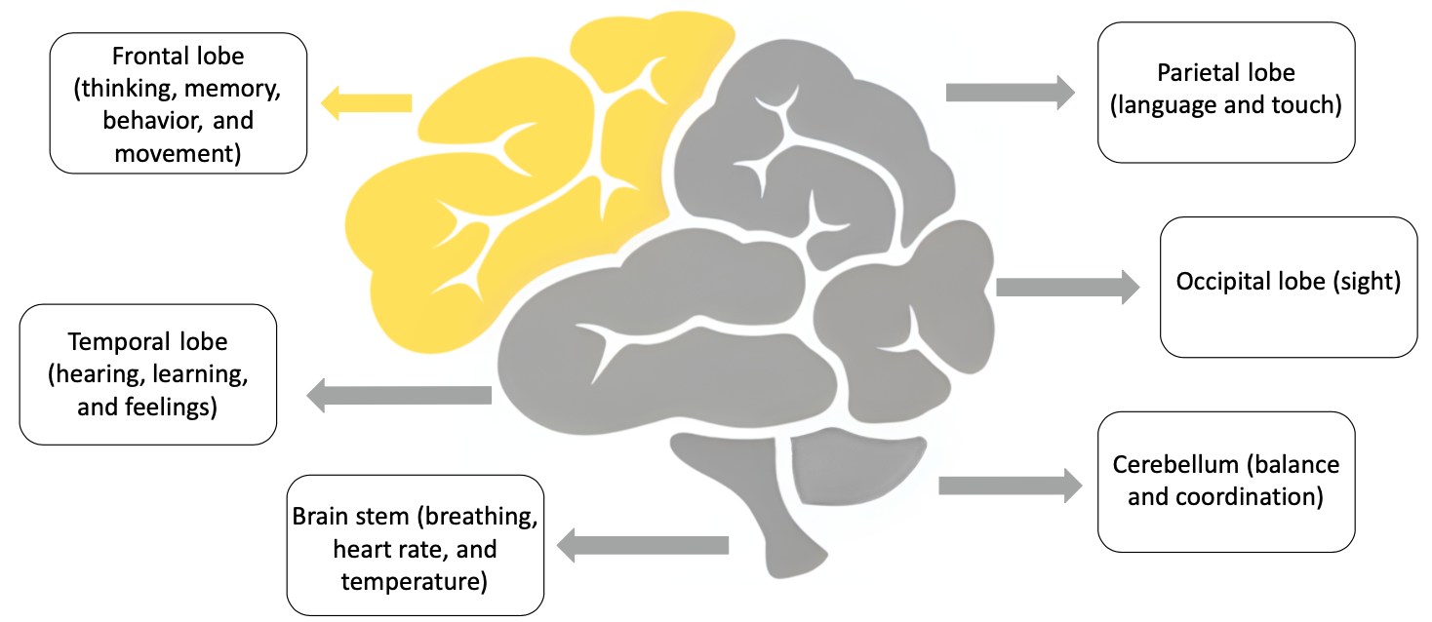
1) Thinking or Cognition
Includes all of our internal mental processes and functions, for example:
Planning
Calculating
Self Awareness
Sequencing
Judgment
Comprehension
Contemplation
Notes:
Say:
There are lots of different areas or types of thinking- check out this brain and the different areas. Did you know your brain has different parts that are responsible for different functions?
Do:
Point out a few different area and what they do. Be sure to point out the LOBES, especially the front lobe as it will come up later.
Ask:
Why do you think it’s important to wear a helmet when biking or playing certain sports?

Slide 27
Functions of the Brain
2) Sensing
Notes:
Say:
The brain is in charge of sensing.
Ask:
What are the five senses?
Vision “seeing”
Hearing
Touch
Taste
Smell
Ask:
Ask students to list ways the 5 senses help to provide them with information.

Slide 28
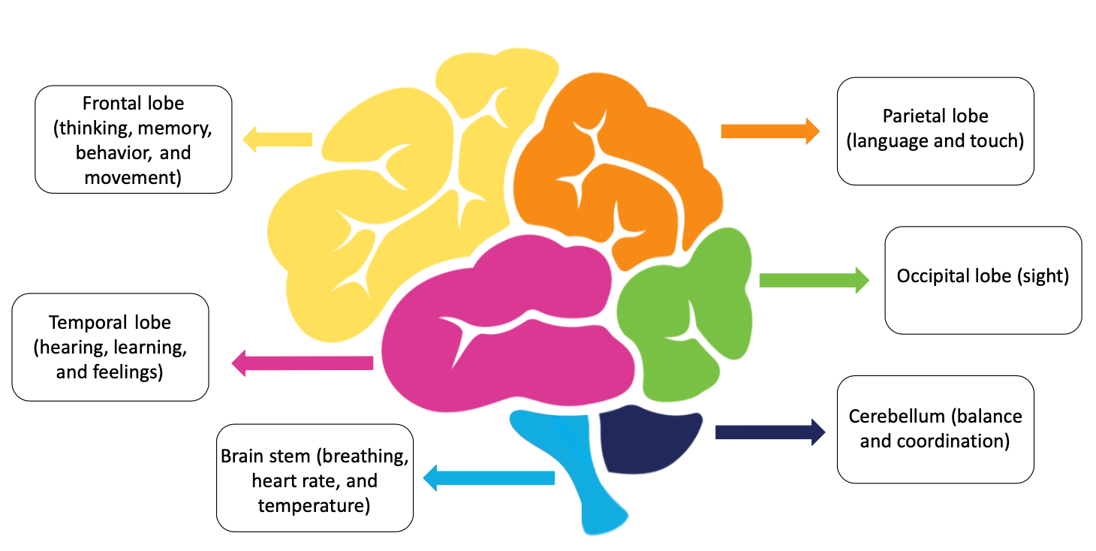
2) Sensing
The ability to use our 5 senses:
Seeing
Hearing
Smelling
Feeling
Tasting
Notes:
Say:
Each part of the brain is in charge of different senses and functions.
When people have an injury to their brains, they may lose certain functions depending which area of the brain is hurt. For example, if you get hit in the back of your head, the Occipital Lobe, you are more likely to have your vision impacted.
Ask:
Look at this image of the brain. Can you find which lobe is responsible for each of our five sense?

Slide 29
Functions of the Brain
3) Emotion or Feeling
Notes:
Do:
Invite students to list as many emotions as they can remember from the previous topic’s activity as a review.
Say:
The brain is in charge of emotions, specifically the limbic system
Do:
Encourage feelings/emotion identification
Ask:
Invite students to list as many emotions as they can remember from the previous topics activity as a review.

Slide 30
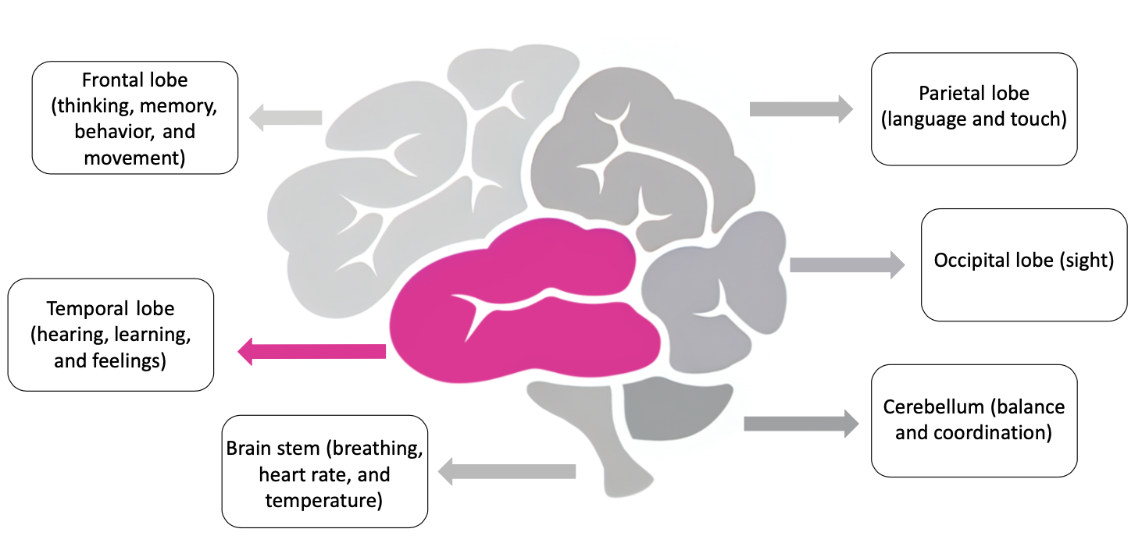
3) Emotion or Feeling
The ability to experience, label, describe and express feelings:
Joy
Anger
Sadness
Hope
Happiness
Sadness
Shame
Loneliness
Guilt
Frustration
Annoyance
Notes:
Say:
Our brain gives us the ability to EXPERIENCE, LABEL, DESCRIBE and EXPRESS feelings…that’s a lot

Slide 31
Functions of the Brain
4) Signaling
(reacting to your environment)
Notes:
Say:
The brain also helps with signaling. This is going to be a strange thought, but your brain is what makes you pull your hand off of something hot, not your hand. Your brain is sending super fast signals back and forth to let you know something is hot.
Do:
Highlight the links between perception and signaling and how there is an interaction between functions.

Slide 32
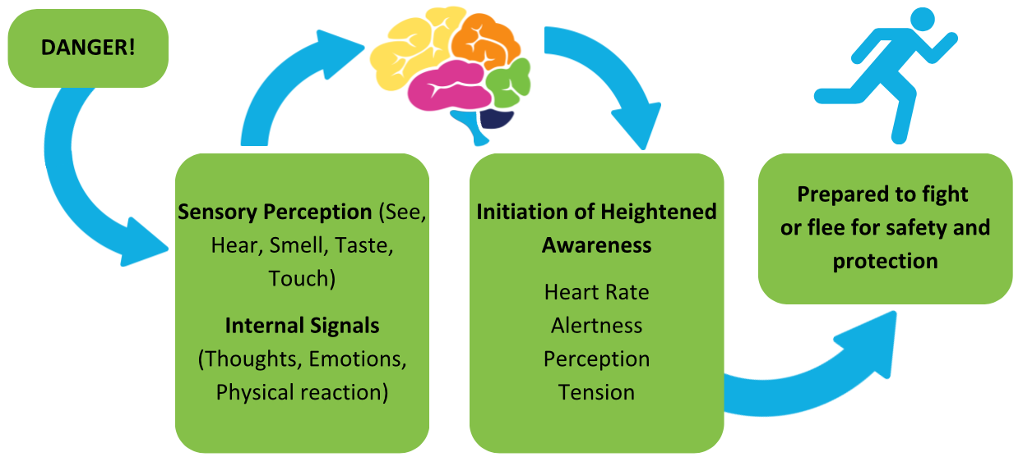
4) What is Signaling?
Signaling means being responsive and reacting to the environment around you
Notes:
Say:
So, what is signaling? This is a picture of it but let’s walk through it
Let’s start with a danger in your environment. For example, you are walking to school and crossing a road, and a car is speeding your way. The sensory perception part of your brain informs you danger is coming and triggers your thoughts, emotions and your body.
Your brain prepares your body for action by increasing your heart rate, your alertness and your perceptions and tension. It puts your body in the optimal condition to respond and keep you safe.
Do:
Point out the process on the slide.
Highlight how activity and action are reliant on brain functions.
Ask:
Any questions?

Slide 33
Functions of the Brain
5) Physical
Notes:
Say:
You brain controls all your physical functions such as breathing, your heart beating, eating, and controlling your bones and muscles.
Do:
Go to the next slide

Slide 34
5) Physical
The brain controls every movement you make with your body – from the smallest blink of an eye to bigger movements like walking, dancing, and swimming!

Slide 35
Functions of the Brain
6) Behavior
Notes:
Say:
Your brain also controls your behaviors- or how you interact with people
Do:
Go to next slide

Slide 36
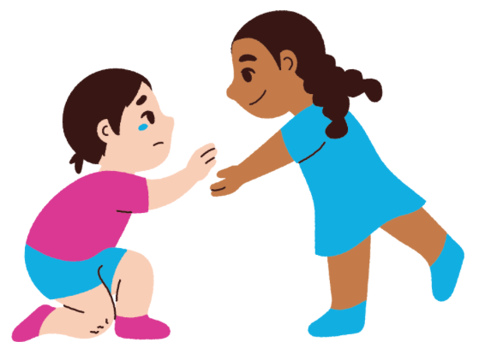
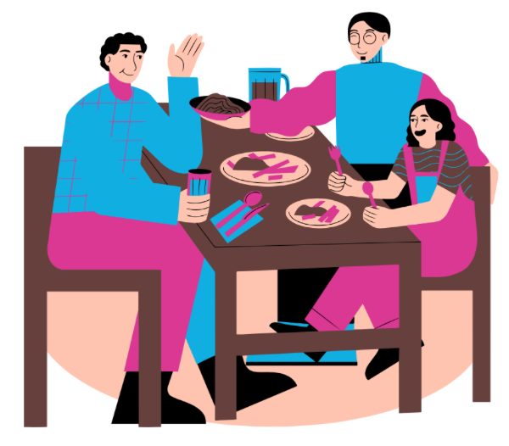
6) Behavioral
What are some behavioral functions (how you interact with people)?
Social interactions
Acts of kindness
Acts of aggression
Goal directed activities
Relaxation activities
Notes:
Say:
Our brain is not only responsible for our physical behavior as discussed, a few slides back but it’s also responsible for how we interact with others.
Do:
Read the slide to cover many behavioral functions

Slide 37
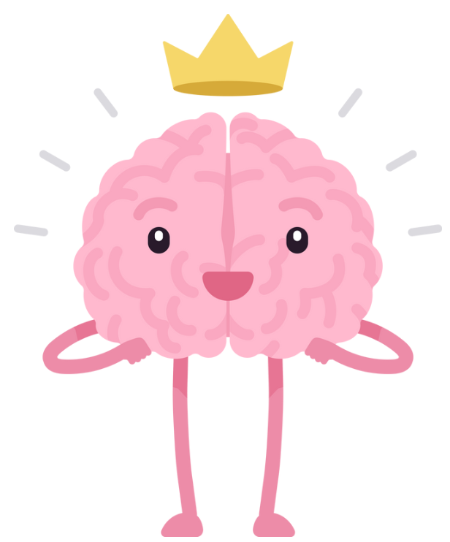
It’s All Connected!
Although we often talk about each of the brain functions separately, they are all interconnected!
Notes:
Do:
Read slide

Slide 38
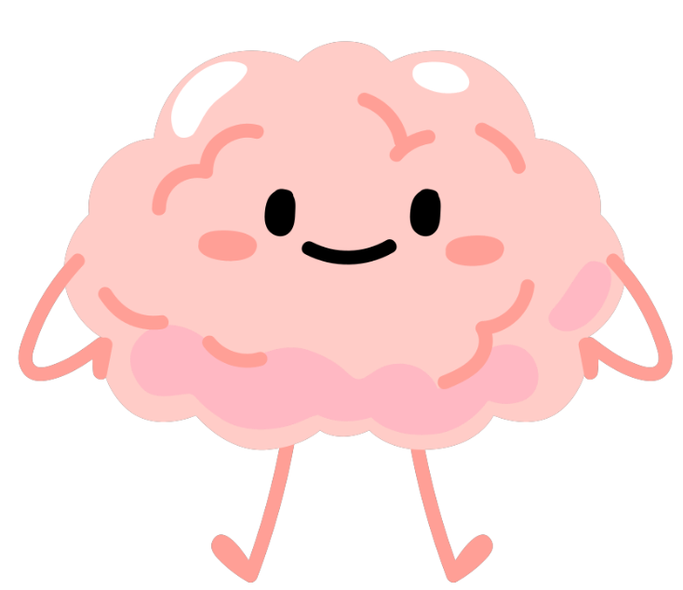
Remember…
You cannot separate the brain from the body.
The brain and body are one!
So, it’s also not possible to separate mental from physical health – what is good for your brain will be good for your body, and vice versa.

Slide 39
Activity 2: Can you Guess
the Mental State?
Notes:
Purpose of activity (conceptual connection): the language used to represent an emotional experience can affect how it is perceived and responded to by self and others.
Draw students’ attention to the fact that the terms they use to describe a situation may be inaccurate and could even aggravate a situation
Say:
We are going to play a game, but first let’s review the mental health states!
We are going to talk about loaded language because the terms we use to describe a situation affect how it is understood by others. When we describe feelings and situations accurately, it makes it easier for others to understand us and help. When we describe feelings and situations inaccurately, it can make it more difficult to get the help we need and even make a situation worse.

Slide 40
Activity 2: Can you Guess
the Mental State?
Answer choices:
1) Mental Disorder or Illness
2) Mental Health Problem
3) Mental Distress
4) No Distress, Problem, or Disorder
Notes:
Say:
Here is a reminder of our Mental Health States. In the next few slides, we will show you some scenarios, pictures, and feelings.
Can you name which state it is?
Do:
Go to the next slide
Determine if this will be done by groups or the entire class.
Consider an incentive for the winner(s), if possible.
Notes for Facilitator:
Reinforce understanding of four mental health states and review the “Key”
Use the next few slides with Emotions Words and Scenarios. Complete as many as you have time for.
Label each slide with one of the following numbers. Answers are in the comments
1 – Mental Illness
2 – Mental Health Problem
3 – Mental Distress
4 – No distress
This game can be played with the entire class, in small groups or however you see fit.

Slide 41
Activity 2: Can you Guess
the Mental State?
Annoyed
1) Mental Disorder
2) Mental Health Problem
3) Mental Distress
4) No Distress
Notes:
Answer: 3 - Mental Distress!

Slide 42
Activity 2: Can you Guess
the Mental State?
Annoyed
1) Mental Disorder
2) Mental Health Problem
3) Mental Distress
4) No Distress
Notes:
Answer: 3 - Mental Distress!

Slide 43
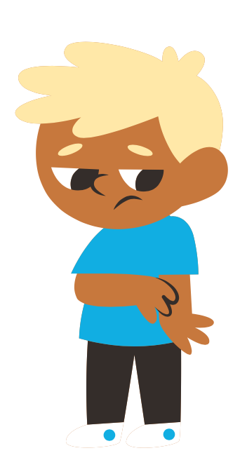
Activity 2: Can you Guess
the Mental State?
1) Mental Disorder
Heartbroken
2) Mental Health Problem
3) Mental Distress
4) No Distress
Notes:
Answer: 3 - Mental distress
Or 2 Mental Health Problem- it could be if it’s too long lasting.

Slide 44
Activity 2: Can you Guess
the Mental State?
1) Mental Disorder
Heartbroken
2) Mental Health Problem
3) Mental Distress
4) No Distress
Notes:
Answer: 3 - Mental distress
Or 2 Mental Health Problem- it could be if it’s too long lasting.

Slide 45
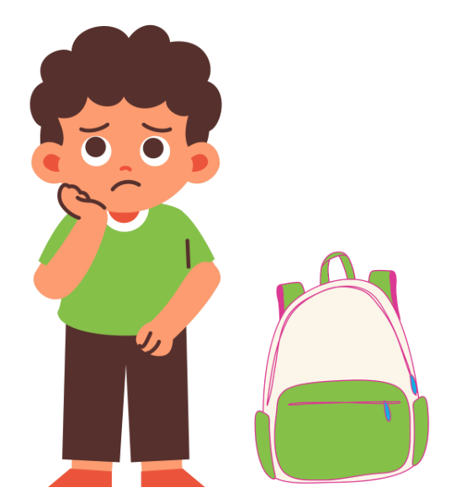
Activity 2: Can you Guess
the Mental State?
You lost your homework
1) Mental Disorder
2) Mental Health Problem
3) Mental Distress
4) No Distress
Notes:
Answer: 3 - Mental Distress!
Explanation: common, not long-lasting; can help us learn to change and adapt (create plan to make sure homework is in backpack)

Slide 46
Activity 2: Can you Guess
the Mental State?
You lost your homework
1) Mental Disorder
2) Mental Health Problem
3) Mental Distress
4) No Distress
Notes:
Answer: 3 - Mental Distress!
Explanation: common, not long-lasting; can help us learn to change and adapt (create plan to make sure homework is in backpack)

Slide 47
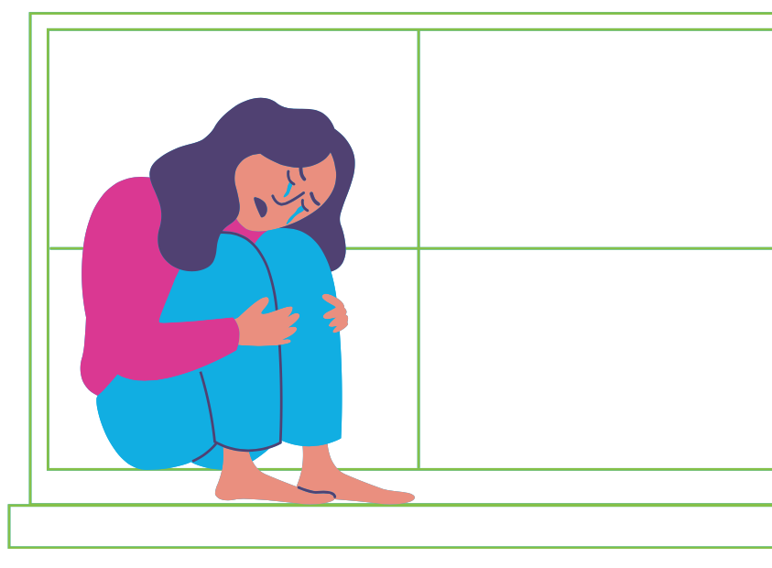
Activity 2: Can you Guess
the Mental State?
1) Mental Disorder
Grieving
2) Mental Health Problem
3) Mental Distress
4) No Distress
Notes:
2 - Mental Health Problem- it is lasting/ongoing

Slide 48
Activity 2: Can you Guess
the Mental State?
1) Mental Disorder
Grieving
2) Mental Health Problem
3) Mental Distress
4) No Distress
Notes:
2 - Mental Health Problem- it is lasting/ongoing

Slide 49
Activity 2: Can you Guess
the Mental State?
Content
1) Mental Disorder
2) Mental Health Problem
3) Mental Distress
4) No Distress
Notes:
4 - No distress

Slide 50
Activity 2: Can you Guess
the Mental State?
Content
1) Mental Disorder
2) Mental Health Problem
3) Mental Distress
4) No Distress
Notes:
4 - No distress

Slide 51
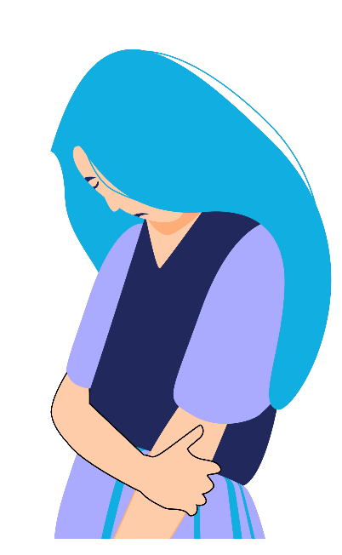
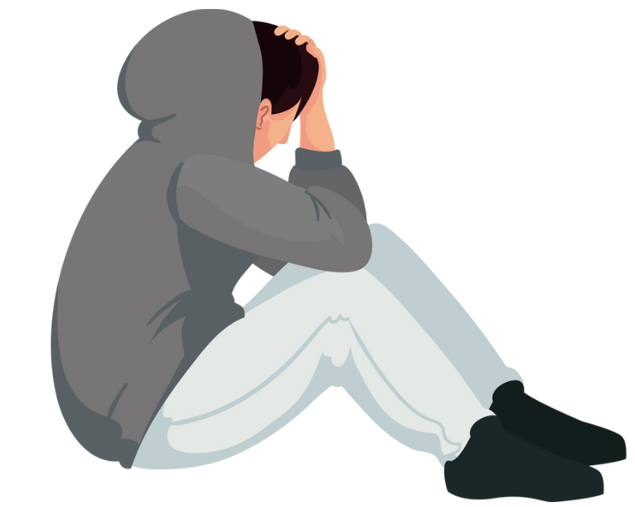
Activity 2: Can you Guess
the Mental State?
Depressed
1) Mental Disorder
2) Mental Health Problem
3) Mental Distress
4) No Distress
Notes:
Answer: 1 - Mental disorder

Slide 52
Activity 2: Can you Guess
the Mental State?
Depressed
1) Mental Disorder
2) Mental Health Problem
3) Mental Distress
4) No Distress
Notes:
Answer: 1 - Mental disorder

Slide 53
Activity 2: Can you Guess
the Mental State?
A student with ADHD is late for class
1) Mental Disorder
2) Mental Health Problem
3) Mental Distress
4) No Distress
Notes:
This is an example of how a person could be in more than one state at a time!
A student could have ADHD (a mental disorder) and be late for class (mental distress).

Slide 54
Activity 2: Can you Guess
the Mental State?
A student with ADHD is late for class
1) Mental Disorder
2) Mental Health Problem
3) Mental Distress
4) No Distress
Notes:
This is an example of how a person could be in more than one state at a time!
A student could have ADHD (a mental disorder) and be late for class (mental distress).

Slide 55
Topic B: Questions?
Important reminders!
The teachers and staff at [insert school] are here to help you. It's normal to need to ask for help sometimes.
The mental health workers in your school are:
[Name mental health professionals]
If you or a friend would like to talk to someone about your mental health please see one of the mental health team members at your school or let your teacher know. They can connect you with the best person to help.
Notes:
Add your name!
It may be a good idea to give out referrals! Personalize this slide for your program/agency/school.

Slide 56
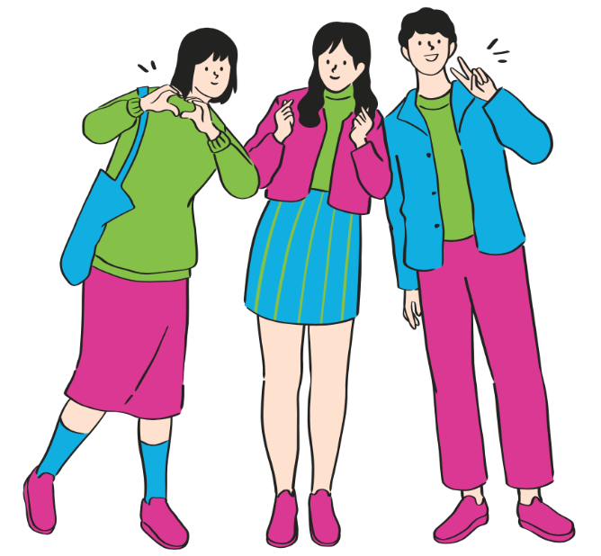
Connect and Learn More!
@MHLiteracy
www.mentalhealthliteracy.org
@MHLiteracy
Notes:
If students wish to access more information use this slide to direct them to teementalhealth.org.

