Slide 1
The Guide
Understanding Mental Health and Mental Illness

Slide 2
Table of Contents
Topic A: What is mental health?
Topic B: How is the brain involved in mental health?
Topic C: What is stigma?
Topic D: How can a person find support?
Topic E: How can positive mental health be maintained?
Notes:
Say:
Welcome back to The Guide! As mentioned, before I will be here for about 5 classes. Last week we worked “Topic B- How is the brain involved in mental health?” and today we are onto “Topic C- What is Stigma?”
Do:
Review class rules or other important items as needed.
Ask:
Can someone remind us of a few things we learned last time we met?
Take 2-3 examples and move on to the next slide

Slide 3
Topic C:
What is Stigma?
[Insert teacher / facilitator name]

Slide 4
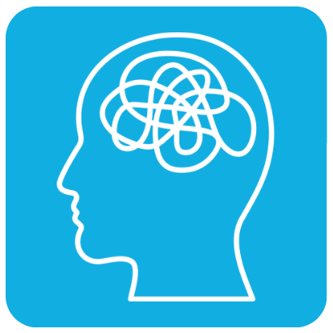
Topic C: What Stigma?
Activity 1:
Defining Stigma
Activity 2:
Myths and Realities of Mental Illness
Activity 3: Conceptual Understanding
Notes:
Say:
Today we will have a few activities to learn about the definition of stigma and clear up misunderstanding around mental illness
1) We will learn about and discuss stigma
2) We will debunk some myths about mental illness
3) We will discuss how what we learn applies to the real world
Do:
Provide agenda of what Topic C will cover (this slide)
Ask:
“Any questions before we get started?

Slide 5
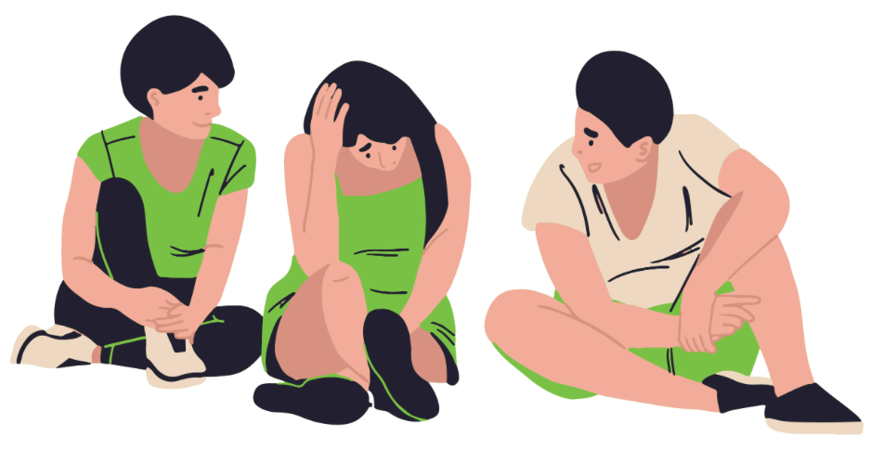
Activity 1: Defining Stigma

Slide 6
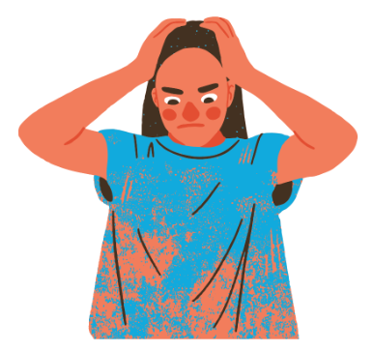
Activity 1: Defining Stigma
My cousin experienced a mental health problem, but she didn’t seek help from anyone because she was afraid the stigma would be harder to handle than the mental health problem.
The stigma surrounding mental health problems grows when the media portrayals of people with mental health problems are inaccurate and exaggerated.
Stigma creates stereotypes, which lead to prejudice, which leads to discrimination.
Notes:
Say:
Review sentences on the screen and start to develop a definition of stigma.
**Remind them to:
Consider the context clues in each sentence.
Think of words that could replace stigma in the sentence and still make sense.
Use those alternate words to help you to craft your own definition of the word stigma. [if using groups] You will work in groups in a minute to come up with a definition
Do:
Share (visually) the three sentences on the slide that include the term stigma used in context.
Once students have read/heard and understand each of the sentences, have them work collaboratively in small groups to generate a definition of the word stigma, based on the context clues provided.
Ask:
What do you think stigma means? Write down your thoughts

Slide 7
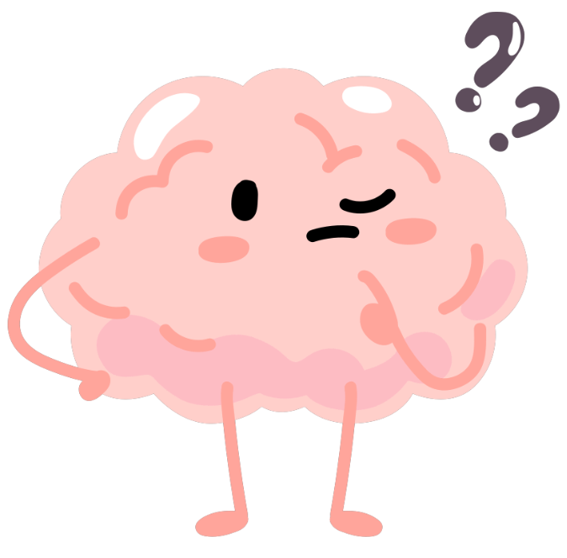
Activity 1: Defining Stigma
Let’s share and compare our definitions of stigma!
Notes:
Do:
Have students share and compare their definitions; see if you can identify similarities and differences
Ask:
If we had to combine all our definitions together…what would our classroom definition be?
Say:
Let’s see how it compares to the dictionary definition

Slide 8
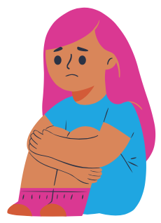
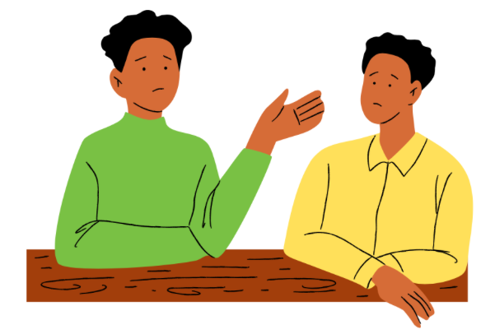
Activity 1: Defining Stigma
stigma
noun; the negative social attitude attached to a characteristic of an individual that may be regarded as a mental, physical, or social deficiency. A stigma implies social disapproval and can lead unfairly to discrimination against and exclusion of the individual.
Notes:
Do:
Reveal a dictionary definition of the word and summarize how it is different or similar to the ones they created
Note: Definition from American Psychological Association - Dictionary of Psychology
Ask:
Does anyone have reactions to this definition compared to the ones created in class? Is it missing anything important?

Slide 9
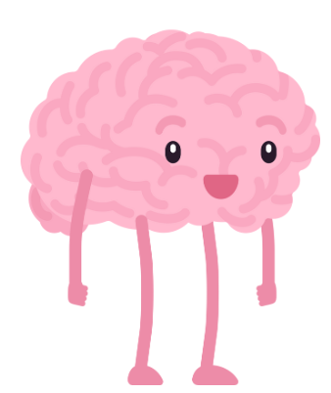
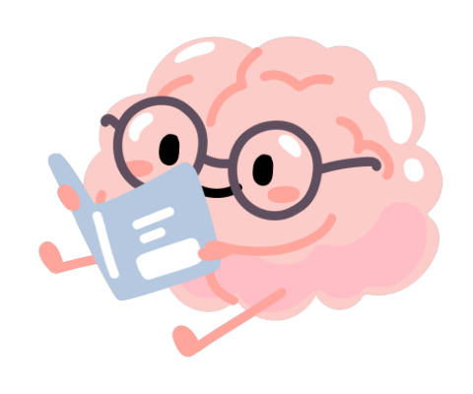
Activity 1: Defining Stigma
Practice using the word stigma correctly by creating your own sentences and/or questions about mental health problems.

Slide 10
Activity 1: Defining Stigma
Why might there be stigma associated with mental illness?
Notes:
Do:
Facilitate discussion; help students connect to their own experiences
Say:
Possible discussion questions:
How does your community think about mental health?
How does your community take care of their mental health?
How do those views impact how you think about mental health?

Slide 11
Stigma and Discrimination
What is discrimination?
What is the relationship between stigma and discrimination?
What is the impact of this behavior?
How is discrimination related to mental illness?
Notes:
Do:
Facilitate a discussion about discrimination and its impact on groups of people to help students understand how stigma influences mental health outcomes. You can help them connect it to their own lives before drawing connections to mental health.
Ask: [if students did not make connection to discrimination]
What do you think discrimination means?
What other topics are stigmatized and what groups are discriminated against across different topics?
How might stigma and discrimination impact mental illness? (use information students generate from the last question to make the connections)
Say:
Stigma can lead to discrimination (the unjust or prejudicial treatment of different categories of people), which impacts how people interpret mental health and symptoms of mental illness, and how they view getting help from mental health professionals and participating in treatment.
For example, by a show of hands, if your caregivers disapproved of mental health services, would you be more or less likely to talk to Mr/Mrs. [enter school-based clinician’s name here]? Why?
If you came to school and all the students said things like mental health isn’t real, laughed at students that went to see [school-based clinician’s name here], and excluded students who were having mental health difficulties, would you be more or less likely to see [school-based clinician]? Why?
Stigma can be a powerful influencer so it is important to understand how to identify it and work to reduce it.
Next, we will go through some myths and facts about mental health so we all have a better understanding. Learning about mental health is one strategy for reducing stigma.

Slide 12
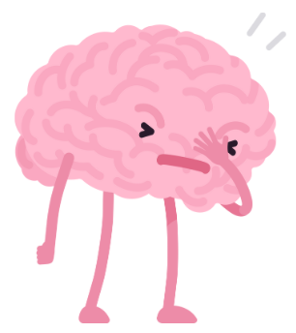
Activity 2: Myths and Realities
of Mental Illness

Slide 13
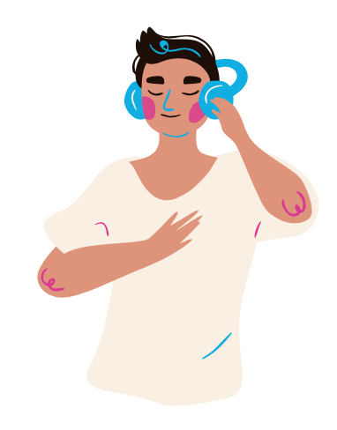
Activity 2: Myths and Realities
of Mental Illness
The following slides will:
Explore different types of stigma and debunk related myths
Show how increasing our personal understanding can reduce stigma surrounding mental health
Notes:
Say:
The stigma surrounding mental illness may be decreased by expanding our personal understandings

Slide 14
Myths and Stigma
Myths are stories used to explain what we do not know
Myths contribute strongly to stigma against people who have a mental illness
One way to help decrease stigma is to challenge myths with data and with scientific knowledge
The opposite of a myth is reality
“Myth busting” may help decrease stigma
Notes:
Say:
Myths are often stories we create to explain things we don't fully understand, but they can also contribute to harmful stereotypes and stigma, especially regarding mental illness.
These misconceptions can lead to discrimination and prejudice against people who are struggling with their mental health. One effective way to combat this stigma is by challenging these myths with facts.
By engaging in "Myth Busting," we can help decrease stigma and create a more understanding and supportive environment for everyone, regardless of their mental health status.

Slide 15
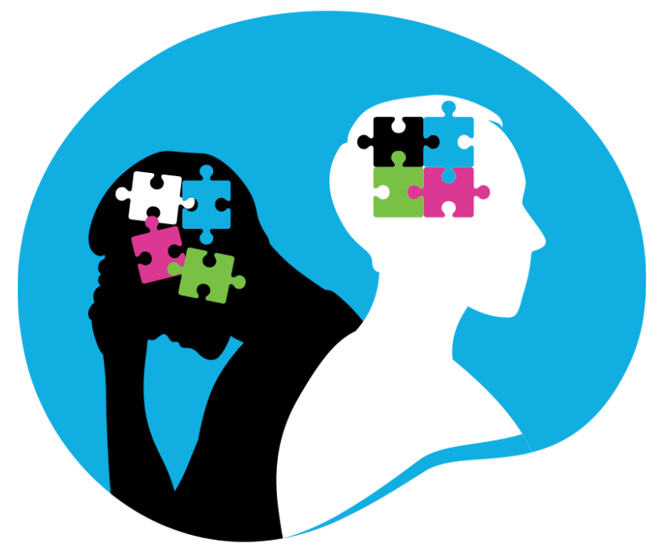
Different Types of Mental Health Myths
Myths about what causes mental illness
Myths about what people who have a mental illness are like
Myths about treatments for mental illnesses
These myths need “Myth Busting”
Notes:
Ask:
Ask students what kind of myths they have heard about people with mental health problems.
How might someone with mental health difficulties feel if they heard these things being said about them?
Say:
Misconceptions surrounding mental illness often revolve around what causes it, what individuals with mental illness are like, and the effectiveness of treatments.
Myths persist about the origins of mental illness, with some believing it's solely due to personal weakness or bad parenting. Additionally, there are misconceptions about the behavior of those with mental illness, often stereotyping them as dangerous or unpredictable.
Furthermore, myths about treatments abound, ranging from the idea that medication is the only solution to the belief that mental illness can be cured through willpower alone.
Challenging these myths with accurate information and promoting understanding and empathy is essential in breaking down stigma and ensuring that those with mental illness receive the support and treatment they need.
On the next few slides we will talk about the stories we’ve heard about the causes of and treatment of mental health disorders and about people with mental illness.
Do:
Compare student suggestions from the previous slide to determine how the myths shared by students could be classified.

Slide 16
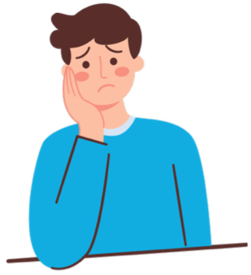
MYTHS about Causes of Mental Illness
What stories do you hear about the causes of mental illness?
Consider how these perspectives could perpetuate stigma and violations of human rights.
Common Myths
Lazy
Weak
No willpower
A bad day
Notes:
Ask:
What stories do you hear about the causes of mental illness
Say:
Common myths if students are stuck:
Mental health difficulties are the result of laziness and people can just snap out of it
that the challenges in our life can’t impact us and our brains
that we just aren’t strong enough and if we were stronger, then you wouldn’t have a mental health problem or illness
Do:
Facilitate conversation on common myths and their possible consequences on seeking help and participating in mental health treatment

Slide 17
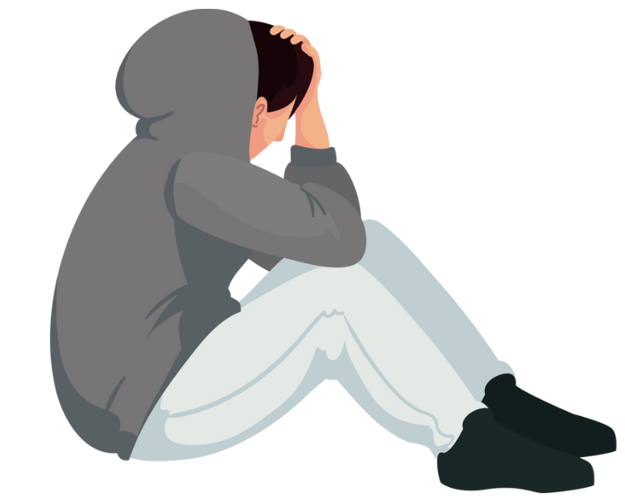
REALITIES about Causes of Mental Illness
Mental illnesses can be the result of disturbances in usual brain function or genetics that lead to difficulties with the control of feelings, thinking and behaviors
Difficult life experiences can impact our mental health
Severe and persistent stress is a risk factor for mental illness
Mental illnesses are not caused by a “moral failing” or laziness.
Notes:
Ask:
What stories do you hear about the causes of mental illness
Say:
Common myths if students are stuck:
Mental health difficulties are the result of laziness and people can just snap out of it
that the challenges in our life can’t impact us and our brains
that we just aren’t strong enough and if we were stronger, then you wouldn’t have a mental health problem or illness
Say:
Mental illness can have various causes, but they often involve a combination of factors.
Sometimes, it's influenced by genetics, meaning it runs in families. If a close family member has a mental illness, you might be at a higher risk.
Life experiences also play a big role. Traumatic events like the loss of a loved one, bullying, or abuse can trigger mental health issues.
Additionally, our brain chemistry and biology can impact mental health. Imbalances in brain chemicals called neurotransmitters can affect how we think, feel, and behave.
Lastly, environmental factors like stress, poverty, or substance abuse can also contribute to mental illness. Remember, it's important to talk to a trusted adult if you're struggling with your mental health, and know that you're not alone in facing these challenges.

Slide 18
MYTHS about People with Mental Illness
What stories do you hear about people with mental illness?
What are some common myths?
Violent
Don’t contribute
Bad friends
Weak
How could dispelling these myths provide hope for people living with mental illness?
Notes:
Ask:
What stories do you hear about the causes of mental illness
Say:
Common myths (if students are stuck):
people with mental health difficulties are violent
people with mental health difficulties can’t/don’t contribute to society
people with mental health difficulties are unreliable friends and partners
people with mental health difficulties are less deserving of protection by the law and their peers
Ask:
How could dispelling these myths provide hope for people living with a mental health problem or mental illness?

Slide 19
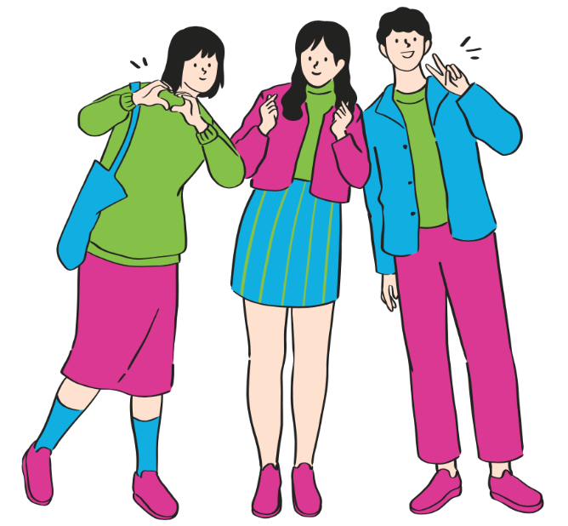
REALITIES about People with Mental Illness
A mental illness rarely leads to violence, but people with a mental illness are more likely to be victims of violence (including bullying)
People with mental illness have the same rights as everyone else
People with a mental illness can be good friends
Notes:
Say:
Myths about mental illness perpetuate harmful stereotypes, such as the belief that people with mental illness are violent, incapable of being good friends, or responsible for their own problems due to personal weakness.
However, the reality is that mental illness rarely leads to violence, and individuals with mental illness have the same rights as everyone else.
They are capable of being supportive friends and can achieve success with proper treatment and support.
Mental illness is not a personal weakness but a brain disorder, and individuals can recover with appropriate treatment.
Unfortunately, these myths can contribute to "self-stigma," where individuals with mental illness feel inferior or embarrassed.
Challenging these myths with facts and understanding is crucial to promoting empathy and support for those with mental illness.

Slide 20
REALITIES about People with Mental Illness
Sometimes a mental illness can make it difficult for a person to work (just like a physical illness), but with proper treatment and support a person with a mental illness can work very well
People with mental illness may experience “self-stigma” which may lead to shame and low self-esteem. It is made worse by the myths others have about people with a mental illness.
Notes:
Say:
Myths about mental illness perpetuate harmful stereotypes, such as the belief that people with mental illness are violent, incapable of being good friends, or responsible for their own problems due to personal weakness.
However, the reality is that mental illness rarely leads to violence, and individuals with mental illness have the same rights as everyone else.
They are capable of being supportive friends and can achieve success with proper treatment and support.
Mental illness is not a personal weakness but a brain disorder, and individuals can recover with appropriate treatment.
Unfortunately, these myths can contribute to "self-stigma," where individuals with mental illness feel inferior or embarrassed.
Challenging these myths with facts and understanding is crucial to promoting empathy and support for those with mental illness.

Slide 21
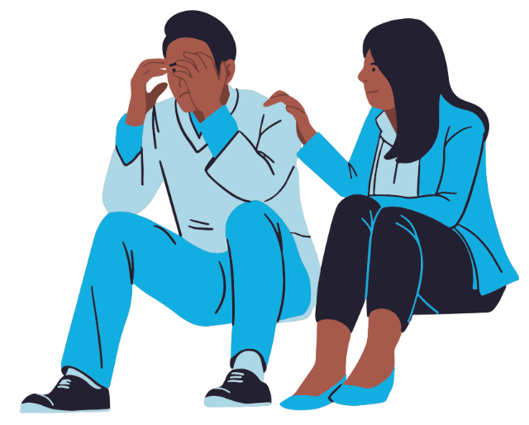
MYTHS about Treatment of Mental Illness
What stories do you hear about mental health treatment?
Overmedicated children
Not effective
Never ending
Children don’t need therapy
Not for me
Social media has all the answers
Therapy is just talking
Notes:
Ask:
What stores do you hear about mental health treatment [examples on animation]
Say:
A few common stories come up when we hear things about mental health treatment.
Some people think children get too many medicines and not enough therapy.
Another story says treatment doesn't really work, making people believe kids won't ever get better so it isn’t worth participating.
Then there's the idea that kids don't need therapy to begin with, which means they might not get the help they need.
Some people also think mental health treatment isn't for them or their families, which can stop them from getting the support they really need.
They may turn to the internet for support which may or may not have helpful information.
Straightening out these stories is important so kids can get the right help to feel better.

Slide 22
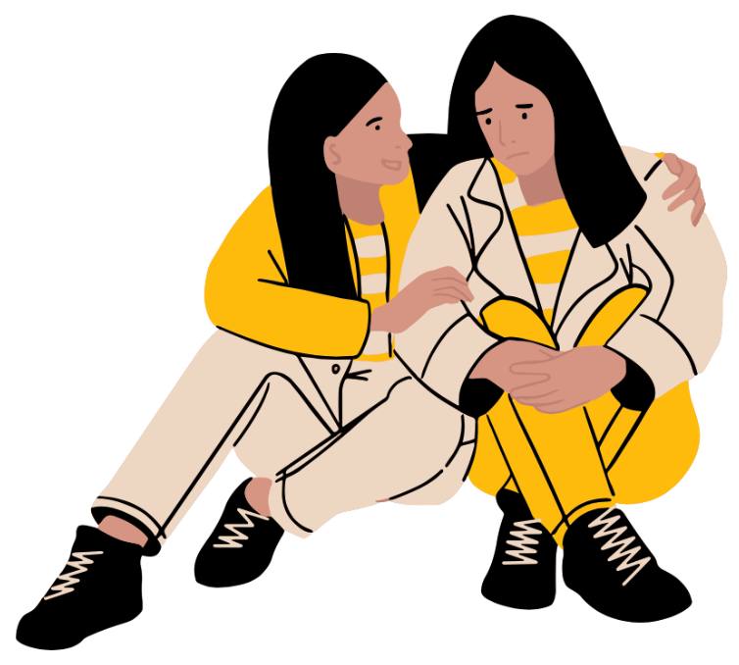
REALITIES about Treatment of Mental Illness
Therapy is a collaboration, requires work and participation. It is not magic.
With the right treatment, most people with mental illness will be able to live well and stay well.
Sometimes conditions can be chronic just like physical conditions but that does not mean people can’t live fulfilling lives while managing symptoms… just like a child with diabetes or asthma.
Finding the right treatment and therapist can be a process. The right treatment may include medication.
Notes:
Say:
Mental health treatment requires active participation and commitment—it's a process of understanding ourselves and our thoughts, feelings, and behaviors.
While not a quick fix, therapy involves hard work and dedication.
With the right treatment and support, most individuals with mental illness can lead fulfilling lives, even if some conditions are chronic.
For instance, someone with autism can learn social skills through training. Finding the right therapy and therapist may take time, especially for those from underrepresented groups.
Cultural competence and openness to learning are crucial for therapists.
Medication can also be part of effective treatment, like helping someone with ADHD focus better or reducing anxiety symptoms.
By being patient and seeking support from qualified professionals, individuals can navigate mental health treatment and improve their quality of life.
Not every treatment works for every person and mental health treatment is a journey.
You may have to try different therapists- find who you like; you may have to try different treatments before you find the one that's best for your and you may have to try different medications since everyone's brain is different.
People going through treatment are strong and resilient! not weak like the myth says!

Slide 23
Bust Myths – Be an Ally
Many people do not know about the realities of mental illness and so they continue to believe myths.
Once you know the realities about mental illnesses, you can help bust the myths by helping others better understand what’s true.

Slide 24
Optional: Extension Activity
You are going to be working on a project aimed at debunking myths about people who experience mental health problems, the causes of mental health problems, or treatments for mental illness.
Myth-Busting example
Plan and present a skit or video aimed at “busting” one or more myths of this concept.

Slide 25
Activity 3: Conceptual Understanding

Slide 26
Activity 3: Conceptual Understanding
Demonstrate your understanding of two or more conceptual connections addressed in this topic:
Stigma leads to discrimination
Stigma can make it harder to ask for help
Stigma may be decreased by expanding our knowledge of mental health facts

Slide 27
Activity 3: Conceptual Understanding
How could your conceptual understanding be applied in a “real world” context?
If this school had a news station, how would you share about the information we just covered?
What would be included on a website about the topic?
How would you share about the topic on social media?
How could you use art to share information about the topic?

Slide 28
Topic C: Questions?
Important reminders!
The teachers and staff at [insert school] are here to help you. It’s normal to need to ask for help sometimes.
The mental health workers in your school are:
[Name mental health professionals]
If you or a friend would like to talk to someone about your mental health, please see one of the mental health team members at your school or let your teacher know. They can connect you with the best person to help.
Notes:
Add your name!
It may be a good idea to give out referrals! Personalize this slide for your program/agency/school.

Slide 29
Connect and Learn More!
@MHLiteracy
www.mentalhealthliteracy.org
@MHLiteracy
Notes:
If students wish to access more information use this slide to direct them to teementalhealth.org.

