Slide 1
The Guide
Understanding Mental Health and Mental Illness

Slide 2
Table of Contents
Topic A: What is mental health?
Topic B: How is the brain involved in mental health?
Topic C: What is stigma?
Topic D: How can a person find support?
Topic E: How can positive mental health be maintained?
Notes:
Say:
Welcome back to The Guide! As mentioned, before I will be here for about 5 classes. Last week we worked “Topic C- What is Stigma?” and today we are onto “Topic D- How can a person find support?”
Do:
Review class rules or other important items as needed.
Ask:
Can someone remind us of a few things we learned last time we met?
Take 2-3 examples and move on to the next slide

Slide 3
Topic D:
How Can a Person Find Support?
[Insert teacher / facilitator name]
Notes:
Do:
Introduce topics and purpose of program
Say:
Today our lesson is going to focus on how and when a person who is experiencing any type of issue or challenge related to their mental health can seek support. We will first start by talking about normal development through the teenage years. Then we will focus on common obstacles or milestones that teens navigate as part of their social development, and we will focus on when things are going as we might expect- which can be within a wide range- and what it might look like when they don’t. After this, we will discuss accessing support, like therapy, and we will delve into what therapy is like from beginning to end. So, let’s get started.

Slide 4
Topic D: How can a Person Find Support?
Activity 1:
The Teenage Experience
Activity 2: Accessing Support
Activity 3: Recovery and Staying Well
Activity 4: Getting Help
Notes:
Say:
Today we will be discussing lots of things!
Today we will be talking about common milestones and obstacles teenagers experience, as well as stressors they may come across.
We will talk about when and how people can find support for mental health stressors.
We will also discuss what it is like to be in treatment, or be in therapy, and how finally, how we can stay well after receiving support, how to recover.
We will also work on an activity to help solidify what we learned about getting help when we need it.
Do:
Provide agenda of what Topic D will cover (this slide)
Ask:
“Any questions before we get started?

Slide 5
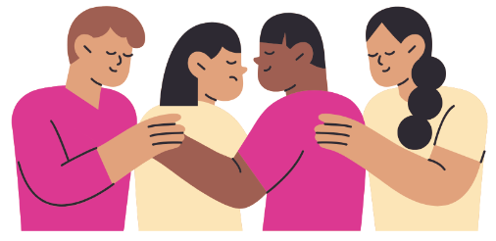
Activity 1: The Teenage Experience
Notes:
Activity I purpose:
To provide students with an understanding of common stressors teens experience and to engage students in thinking about what it might look like if a teen was struggling to navigate these stressors and could require additional mental health support.

Slide 6
The Teen Age Experience: Ages 10-13
Puberty starts (females usually mature 1-2 years earlier than males)
May be challenging to balance family obligations with wanting to be independent
Become more aware of physical attractiveness and physical changes
Become more aware of yourself as a person with future wants/wishes
Notes:
Say:
We are going to start by going through what teens age years are like.
(Have someone read the slide). Who can read this slide for me?

Slide 7
The Teen Age Experience: Ages 10-13
Often have high expectations and lofty goals for the future, sometimes not realistic (e.g., being famous)
Desire to make more friends and test authority figures
Behavior, mood, and motivations change often
Start to become interested in romantic relationships
May have difficulty thinking things through before acting
Notes:
Say:
(Have someone read the slide). Who can read this slide for me?

Slide 8
The Teen Age Experience: Ages 14-16
Most likely to experience conflict with your parents
Want to spend most of your time with friends
Less interested in family activities
Puberty for some may be completed
Desire to be like friends and peers (e.g. clothing, language, values)
Continued focus on yourself
Increased ability to communicate ideas, thoughts, and feelings
Begin to develop your own opinions, values and identity
Notes:
Say:
(Have someone read the slide). Who can read this slide for me?

Slide 9
The Teen Age Experience: Ages 17-21
Start to experience responsibilities that come with being an adult
Start to have more positive experiences with your family
Able to start making decisions independently
Even better ability to express thoughts, ideas, and emotions
Less concerned with your appearance and increased self-confidence
Less interested in being the same as your friends and peers
Better at problem solving
Strengthened values
Deeper and more stable emotions
Notes:
Say:
(Have someone read the slide). Who can read this slide for me?

Slide 10
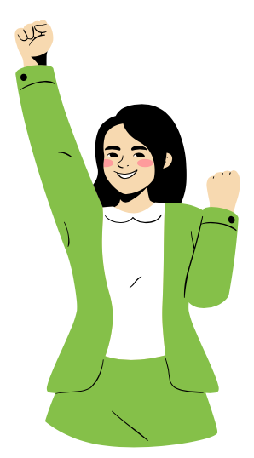
Successes and Failures
It’s okay to make mistakes!
Successes and failures are both important in how we grow!
Notes:
Say:
As we navigate these milestones and challenges that come with being a teen, we must keep in mind that it is ok to make mistakes. In fact, it’s important for you to fail and make mistakes sometimes. It’s how you learn to cope with disappointment, pick yourself back up, and find the strength to try again. These experiences contribute to the way the brain develops. And just like learning to deal with failure shapes the brain, so does experiencing success.
It’s just as important for your development and self-esteem that you find areas to succeed and thrive. Having a balance of these positive experiences and challenging experiences helps you develop into a confident and capable adult.
While you are experiencing challenges along the way, you may experience some stress – which can be very healthy for you- but we will also consider today when the stress is no longer helpful and might indicate a need for support.

Slide 11
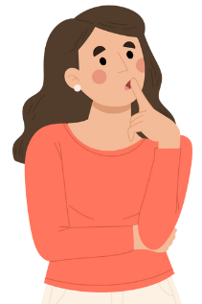
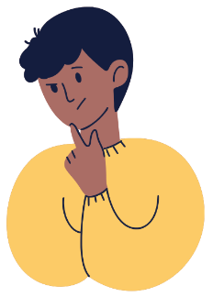
The Teenage Experience
What do you wish the adults in your life knew about what it is like being a young person today?
Notes:
Say:
Before we start talking about themes, let’s think about this: What do you wish your caregivers or parents or teachers knew about what it is like being a young person today?
You all have had very unique experiences from what adults experienced at your age, especially going through COVID, experiencing the goods and bads about social media, etc. The adults in your life probably cannot relate based on their own experiences.
Ask:
What do you wish the adults in your life new or understood better?

Slide 12
The Teenage Experience
We are going to break up into 4 groups
Each group will have a topic relevant to teens:
Healthy Relationships
Technology & Social Media
Suicide and Self-Harm
Substance Use
Each group will read their topic and answer the 2 questions on the next slide
Notes:
Say:
These are common topics or problem areas teens experience. Let’s take some time to examine them further. We are going to break up into 4 groups. Each group will receive hand-outs to read together. After you read it as a group, please answer these 2 questions that you will find on your hand-out as well.
Do:
Break the class up into 4 groups so each topic is covered. Assign a reader, note taker, time keeper, and reporter (who will share with the class).

Slide 13
The Teenage Experience
Questions for each group:
What are signs, indicators, or behaviors that a teen is experiencing no distress in this area or that things are functioning well?
What are signs, indicators, or behaviors that a teen might be experiencing mental distress or a mental health problem?
Notes:
Say:
These are the questions each group will answer regarding your specific topic.

Slide 14
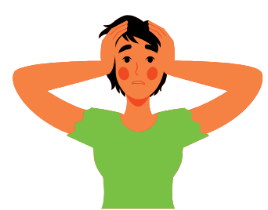
Other Reasons Teens Seek Support
Anxiety Symptoms
Excessive worry
Trouble controlling worry
Stomach aches, headaches, heart racing, going to the nurse frequently
Avoiding things or people
Feeling on edge
Trouble concentrating or focusing
Notes:
Say:
In addition to the areas we talked about, teens also seek out support when they notice the following:
Common Anxiety symptoms (read slide) Physical symptoms can include headaches or stomach aches.; avoiding activities or people even when they wish they didn’t
Common Depression symptoms: feeling sad but not because you lost someone, like a death; saying or thinking poorly of yourself; either eating more than you used to or not eating as much; sleeping too much or conversely sleeping too little.
Ask:
Can you think of other ways people might notice symptoms of depression or anxiety?
Say:
You do not need to be in a full-blown crisis to seek help, it is never too early or too late!

Slide 15
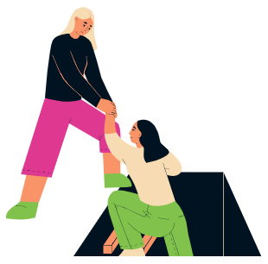
Other Reasons Teens Seek Support
Depression Symptoms
Frequent sadness
Changes in appetite or sleep (sleeping too much or sleeping too little)
Negative thoughts about yourself
Preferring to be alone
Thoughts of wanting to hurt yourself or dying
No interest in fun things you usually like
Notes:
Say:
In addition to the areas we talked about, teens also seek out support when they notice the following:
Common Anxiety symptoms (read slide) Physical symptoms can include headaches or stomach aches.; avoiding activities or people even when they wish they didn’t
Common Depression symptoms: feeling sad but not because you lost someone, like a death; saying or thinking poorly of yourself; either eating more than you used to or not eating as much; sleeping too much or conversely sleeping too little.
Ask:
Can you think of other ways people might notice symptoms of depression or anxiety?
Say:
You do not need to be in a full-blown crisis to seek help, it is never too early or too late!

Slide 16
Other Reasons Teens Seek Support
The topics discussed can become things that lead to a mental health problem or mental disorder
Seek help early and it is never too late
Talk to a trusted adult- parent, caregiver, teacher, school counselor, etc., and let them know what you have been experiencing and feeling, and that you would like to talk to someone who can help
Text 988 because of a crisis
Notes:
Say:
It can feel overwhelming if you think you might have a mental illness or other serious mental health concern. The first and most important thing you can do is talk to someone you trust. Tell your parents, caregivers, or a responsible adult that you can confide in (such as a teacher or a school counsellor) what you’ve been experiencing, how you’ve been feeling, and that you would like to talk to someone who can help, like your doctor or a mental health therapist. Your family doctor or pediatrician can help you figure out what is going on and refer you to someone who specializes in mental health, if necessary. Don’t lose hope. Most common mental illnesses are very treatable. Don’t let anybody convince you that going to therapy, taking medications, or getting any other type of help is weak. Seeking help is never shameful. It takes courage to admit you need help and even more bravery to take the steps to get help. Note: If you are feeling suicidal, call 988 and/or go to the hospital immediately.

Slide 17
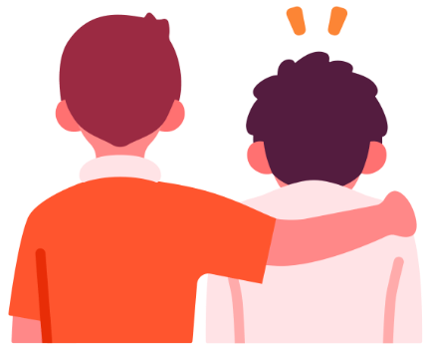
Activity 2: Accessing Support
Notes:
Activity II purpose:
To help students understand what therapy is like, how to get help, and what they can do as the recipient of support
Conceptual connection:
getting help early increases the chances that a person will live well with a mental illness
a range of evidence-based treatments and supports are available to assist with recovery
Say:
We are now going to talk about what therapy is and what kinds of therapies and supports exist in the mental health field. We will also talk about how therapy helps people with mental health issues and what these therapies actually do.

Slide 18
What Do Treatments Do?
Help control the signs and symptoms of the illness
Help improve functioning (at school/work/home, relationships, etc.)
Help prevent the illness from returning
Help improve overall health and well-being
Notes:
Ask students for the difference between a sign (what others see) and a symptom (what the person feels/experiences)
Say:
treatments are all aimed at the brain and how it functions.
Ask:
What are the differences between a sign (what others see) and a symptom (what the person feels/experiences),

Slide 19
What Exactly is “Treatment”?
Treatments include therapy, counseling, and mental health support
Providers can be a therapist, counselor, mental health clinician, social worker, clinician, and/or psychologist
A psychiatrist prescribes medication
Treatments require a collaboration between the youth, the clinician and the family
Families can learn more at: www.mentalhealthliteracy.org
Notes:
Explain that it is important to be informed and that a parent is their own best advocate.
Say:
Treatments for mental health issues are generally referred to as therapy or counseling, or mental health support.
A person providing this treatment is often called a therapist, counselor, mental health clinician, social worker, clinician, psychologist, etc. Sometimes what the person is called depends on the schooling and the type of professional license they have. These people DO NOT prescribe medication, but a psychiatrist does. A psychiatrist might also provide therapy with prescribing and managing medication, but not always.
The treatment team will include whoever is providing your therapy services, the psychiatrist if you have one, your family, and most importantly, YOU
Ask:
Why is the client (“you”) so important in the process of therapy?
Can you think of other names for therapy or being therapy that you might have heard?

Slide 20
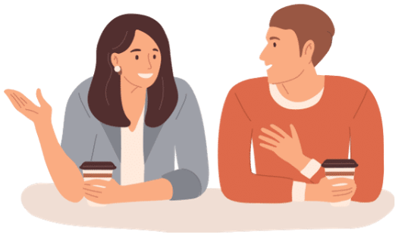
More About Treatment
People respond to interventions and providers in different ways. Different interventions work for different people.
It’s up to the provider (the therapist or counselor) and their client to figure out what works best.
Talk therapy is helpful and effective for people with many different diagnoses.
Sometimes medication can help too. This decision should be made with everyone able to share their opinion and thoughts, including the parent, the provider, and the client.
Notes:
Explain that, as with many things in life, the types of treatment can differ or vary depending on the needs of a person.

Slide 21
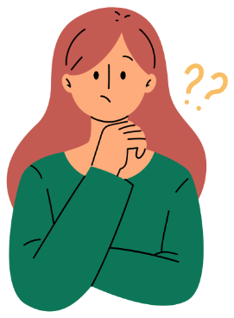
If You Are Starting Therapy…
Questions you could ask your therapist:
What is my diagnosis and what does it mean?
What are my treatment goals? In other words, what are we trying to accomplish? (You can and should be a part of developing these goals!)
What is treatment like and how does it work for me?
How long will I be in therapy?
Any other questions you have! Your therapist should be open to answering any questions you might have!
Notes:
If you are starting therapy, because you are a crucial part of the treatment team, there are some things you should know or ask
Say:
To start, you can feel free to ask your therapist questions!
Do:
Read slide
Ask:
What are other questions you might ask a new therapist?

Slide 22
If You Are Starting Therapy…
You should feel…
Heard
Challenged
Respected
Like you can ask questions
… and keep in mind: It might be awkward or hard to start therapy, but it should get better in time!
Notes:
If you are starting therapy, because you are a crucial part of the treatment team, there are some things you should know or ask

Slide 23
If You Are Starting Therapy…
If you cannot find a therapist right away, look around for other support until you can.
Who are some trusted adults you can think of that might be able to help?
Notes:
Say:
Sometimes it can be hard to find a therapist who has immediate openings, so it could be helpful to identify other support people you can turn to
Do:
Start a list on the board
Ask:
Who are some trusted adults you can think of that might be able to help? (school counselor, Church community or other religious community members, other trusted adults?)

Slide 24
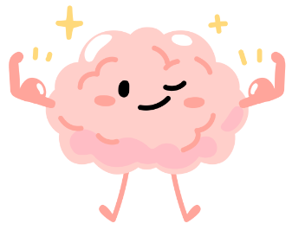
Activity 3: Recovery and Staying Well
Notes:
Activity III purpose:
To help students understand what it means to be well and to achieve mental wellness through therapy, how they can recognize this in themselves, and how to maintain wellness in their lives

Slide 25
Activity 3: Recovery and Staying Well
You might be ready to complete therapy when you have achieved all of your treatment goals and you can use your mental health management strategies independently.
Notes:
Explain that recovery may not mean returning to the way they were before, it could be learning to live with a “new normal.“
It is a constant, active pursuit
Say:
After you have been in therapy for some time and have made progress, you might start considering being done with your treatment. How long this might take is hard to say but it could be anywhere from a few weeks to a few months, or even a year or more.
You can start this conversation with your provider when you feel well, and you want to think about moving toward independence/discharging from therapy.

Slide 26
Activity 3: Recovery and Staying Well
Wellness is supported through treatment as well as:
Social supports
Meaningful daily activities
Healthy lifestyle
Socializing and Friendships
Having your basic needs met at home
Notes:
Discuss social supports and the significant role it plays in healthy living.
Say:
Once you have achieved what you and your provider want to achieve and you discharge or end therapy services, it is important that you carry on the work you have done. One way to support being able to do so is make sure you have a lifestyle based in wellness.
Do:
Read slide
Ask:
Why are these items on the slide important to a person’s wellness?

Slide 27
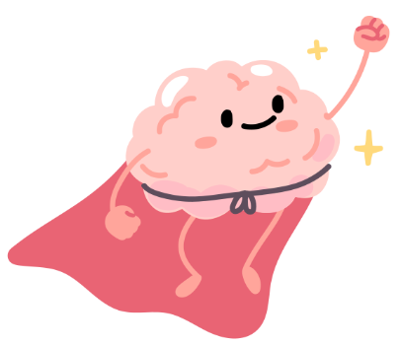
What You Need To Know
When someone needs support to improve their mental health, the sooner they get proper treatment, the better the chance of a good outcome!
So what can you do?
Get treatment if you need it.
Encourage friends to seek help if they need it.
Fight stigma against mental health by dispelling myths and only sharing accurate information.
Notes:
Say:
While it is never too late to get help, it is best to get help as soon as you realize- or even think- you need it. The sooner you get the help you need, the better the outcome.
Ask:
Why should we get help as soon as possible? Why not wait?
Why is it important to fight against stigma? How could this impact someone getting help when they need it ?

Slide 28
For More Information…
Just like 911 is the medical emergency number… 988 is a the mental health crisis hotline
Visit MentalHealthLiteracy.org for more mental health info
teenline.org gives personal teen-to-teen education and support before problems become a crisis.
The JED Foundation: www.jedfoundation.org
National Alliance on Mental Illness: www.nami.org
National Institute of Mental Health: http://www.nimh.nih.gov/health/topics/index.shtml
Substance Abuse and Mental Health Services Administration: www.samhsa.gov
The Trevor Project - Suicide Prevention for LGBTQ+ Young People
Trans Student Educational Resources
Notes:
This information should be made readily accessible to students, staff and families. Consider posting it to SchoolZonem google classroom, as part of a class update.

Slide 29
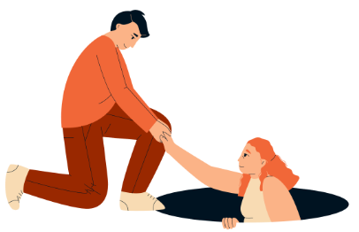
Activity 4: Getting Help
Notes:
Activity IV purpose:
Activity IV purpose is to help students consolidate their learning by problem solving What If… scenarios around making choices about accessing help.

Slide 30
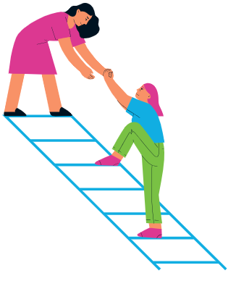
Activity 4: Getting Help
Divide into groups
Arrange “what if” scenarios in a circle (make the circle wide enough that a spinner or pencil can fit in the middle)
Take turns spinning the spinner and:
Read the situation aloud
Provide your opinion on what could be done in the situation
Ask your group members for their opinions
Notes:
Explain to students that they will be engaged in a problem-solving activity in which they will be asked to speculate about the possible action they could take in a variety of situations involving young people in distress. Organize students into groups of four to six, sitting in a circle. Hand out the sets of cards from the student sheet What if… Scenarios (https://docs.google.com/document/d/1Db73gxwMX01pqA29llfxkwKjFazU8qjVpI_CvAZlPdI/edit) and have students lay them out in a circle with enough room inside the circle for a spinner. In turn, each of the participants takes a spin and reads out the card to which the spinner points. The person who spun the spinner is first given time to speculate about what to do in such a situation, and then the other students help out by adding their own perspectives, questions or problems. Have students discuss the above questions.
Say:
We are going to practice what we learned by going through these “what if” scenarios. Your group is going to decide the actions the people in the scenarios could take to manage their distress.
Do:
Divide students into groups and hand out spinners (if using) and scenarios

Slide 31
Scenarios Debrief
Were there any disagreements in your group about what was best to do?
Which was the scenario most likely to actually happen out of those you discussed?
Which do you think would be the hardest scenario to deal with if it happened to you or someone you know?
What sorts of fears or concerns would stop people from seeking help or telling someone else in these situations?
What kinds of things would motivate someone to seek help or tell someone their concerns in the situations you discussed
Notes:
Explain to students that they will be engaged in a problem-solving activity in which they will be asked to speculate about the possible action they could take in a variety of situations involving young people in distress. Organize students into groups of four to six, sitting in a circle. Hand out the sets of cards from the student sheet What if… Scenarios (https://docs.google.com/document/d/1Db73gxwMX01pqA29llfxkwKjFazU8qjVpI_CvAZlPdI/edit) and have students lay them out in a circle with enough room inside the circle for a spinner. In turn, each of the participants takes a spin and reads out the card to which the spinner points. The person who spun the spinner is first given time to speculate about what to do in such a situation, and then the other students help out by adding their own perspectives, questions or problems. Have students discuss the above questions.
Do:
Debrief. Read the slide and call on different groups.

Slide 32
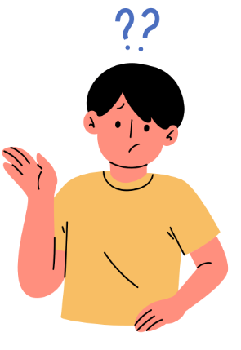
Conceptual Understanding
Notes:
Activity IV purpose:
Activity IV purpose is to help students consolidate their learning by problem solving What If… scenarios around making choices about accessing help.

Slide 33
Conceptual Understanding
Demonstrate your understanding of two or more conceptual connections addressed in this topic
Recognizing different perspectives within relationships improves communication about mental health
Mental illnesses, like chronic physical illnesses, can be effectively treated
Getting help early increases the chances that a person will live well with a mental illness
A range of evidence-based treatments and supports are available to assist with recovery
Notes:
Say:
We covered a lot today. Choose an activity above to represent what you learned today. This should be fun. You have an option to participate in one of the creative activities shown on the slide to illustrate your understanding of the key concepts we talked about today
Ask:
What were some takeaways for you today?
Do:
Pass out materials and provide an example of an activity the students can do
Conceptual Connections:
Recognizing different perspectives within relationships improves communication about mental health
Mental illnesses, like chronic physical illnesses, can be effectively treated
Getting help early increases the chances that a person will live well with a mental illness
A range of evidence-based treatments and supports are available to assist with recovery
If this school had a news station…how would you share the information we just covered?
What would be included on a website about the topic?
How would you share about the topic on social media?
How could you use art to share information about the topic?

Slide 34
Conceptual Understanding
How could your conceptual understanding be applied to a real-life example?
If this school had a news station, how would you share the information we just covered?
What would be included on a website about the topic?
How would you share about the topic on social media?
How could you use art to share information about the topic?
Notes:
Say:
We covered a lot today. Choose an activity above to represent what you learned today. This should be fun. You have an option to participate in one of the creative activities shown on the slide to illustrate your understanding of the key concepts we talked about today
Ask:
What were some takeaways for you today?
Do:
Pass out materials and provide an example of an activity the students can do
Conceptual Connections:
Recognizing different perspectives within relationships improves communication about mental health
Mental illnesses, like chronic physical illnesses, can be effectively treated
Getting help early increases the chances that a person will live well with a mental illness
A range of evidence-based treatments and supports are available to assist with recovery
If this school had a news station…how would you share the information we just covered?
What would be included on a website about the topic?
How would you share about the topic on social media?
How could you use art to share information about the topic?

Slide 35
Topic D: Questions?
Important reminders!
The teachers and staff at [insert school] are here to help you. It’s normal to need to ask for help sometimes.
The mental health workers in your school are:
[Name mental health professionals]
If you or a friend would like to talk to someone about your mental health, please see one of the mental health team members at your school or let your teacher know. They can connect you with the best person to help.
Notes:
Add your names!
It may be a good idea to give out referrals!

Slide 36
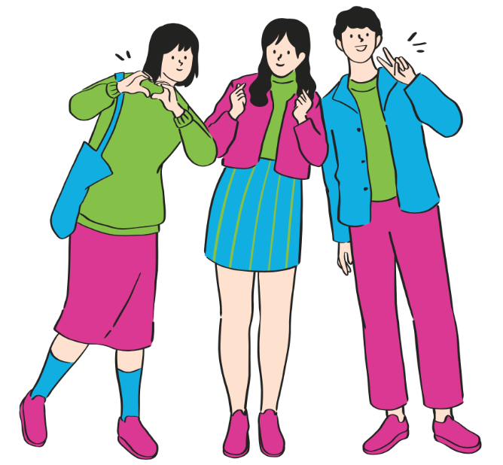
Connect and Learn More!
@MHLiteracy
www.mentalhealthliteracy.org
@MHLiteracy
Notes:
If students wish to access more information use this slide to direct them to teementalhealth.org.

